Slide 1
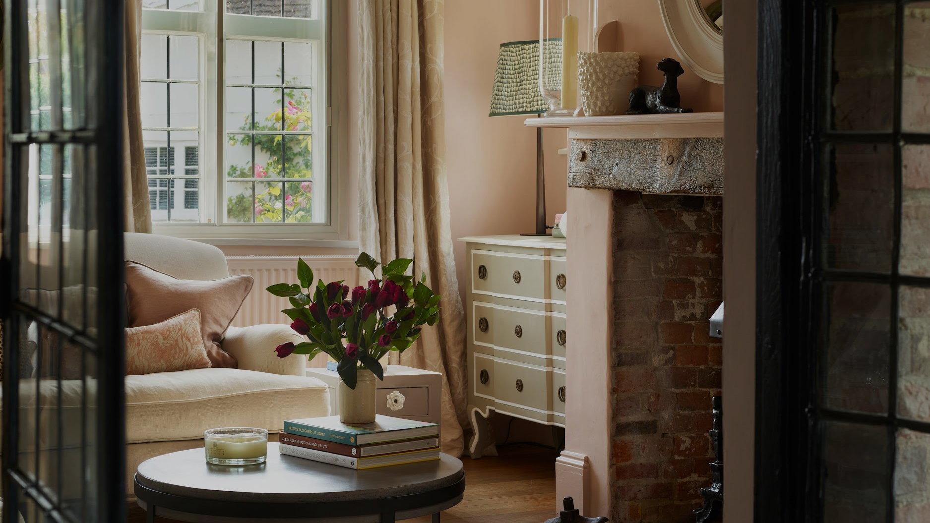


M E D I A P A C K
Notes:
Cover slide, sofa living room fancy,

Slide 2



EDITOR'S LETTER
Country Homes & Interiors is the only UK magazine dedicated to modern country design and living. Each month, we feature the vibrant, contemporary style embraced by a new generation of country lovers, including curated decorating inspiration, stunning rural properties and glorious gardens, plus expert advice to help readers renovate and refurbish their own joyful and beautiful homes.
Country Homes & Interiors introduces readers to the movers, shakers and makers leading the way in how our homes look, feel and function. We know that great design doesn’t only reside in cities; that trends reach villages and market towns; and that people invest in their interiors to create homes full of character and charm. In fact, we believe that the countryside is a source of brilliant style ideas, incredible talent and world-leading values in sustainability and innovation. And that’s what we celebrate in our pages.
We’re the magazine for rural dwellers and dreamers. Whether our readers live surrounded by fields or by suburbs, were born in the countryside or simply love the lifestyle it offers, they will find their style and spirit represented in Country Homes & Interiors.
Andrea Childs
Editor

Slide 3
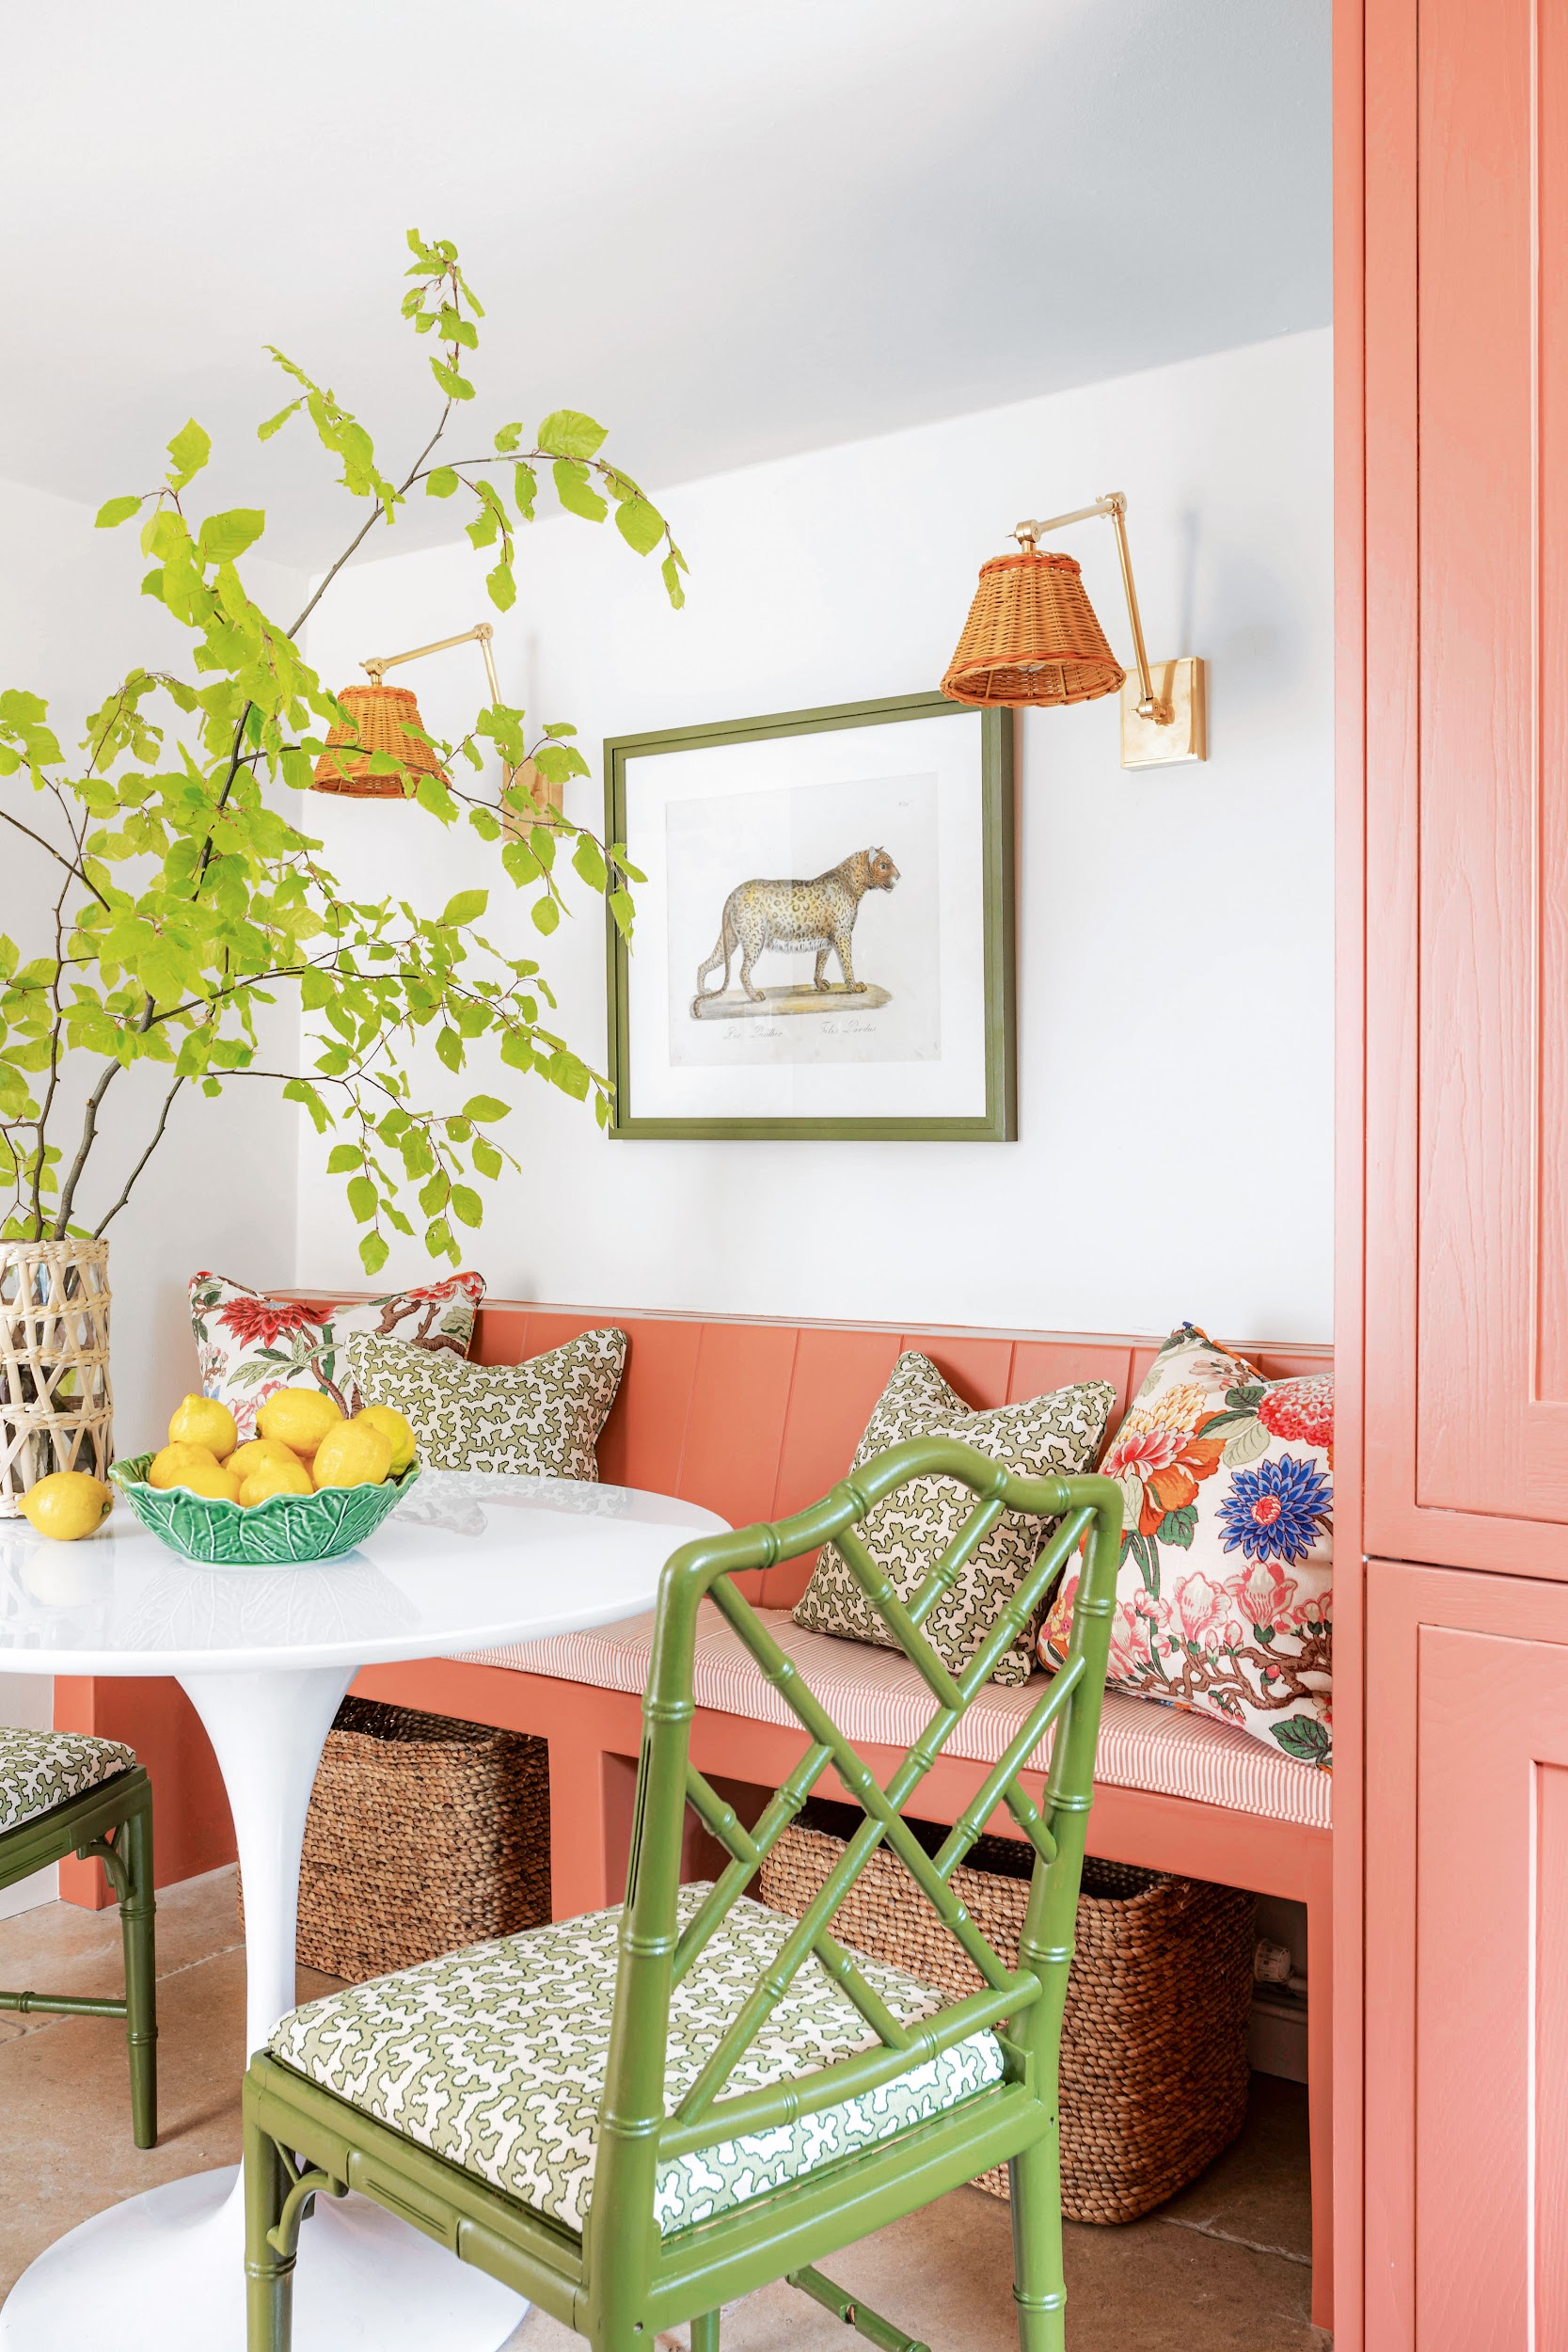
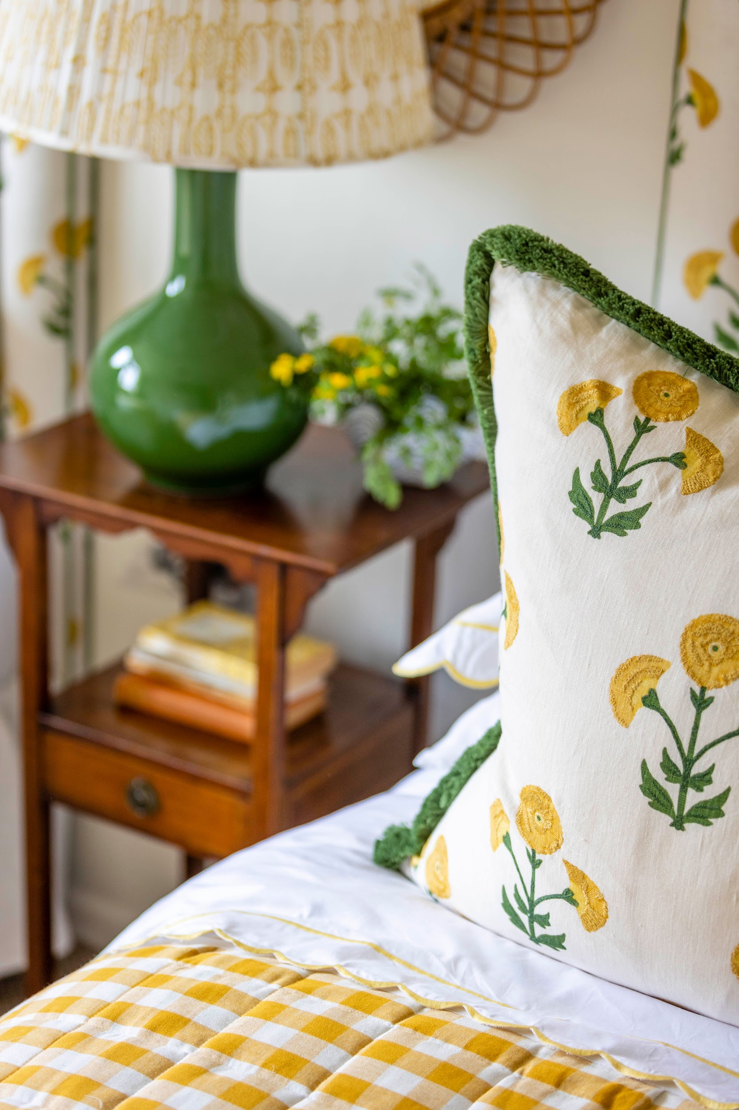
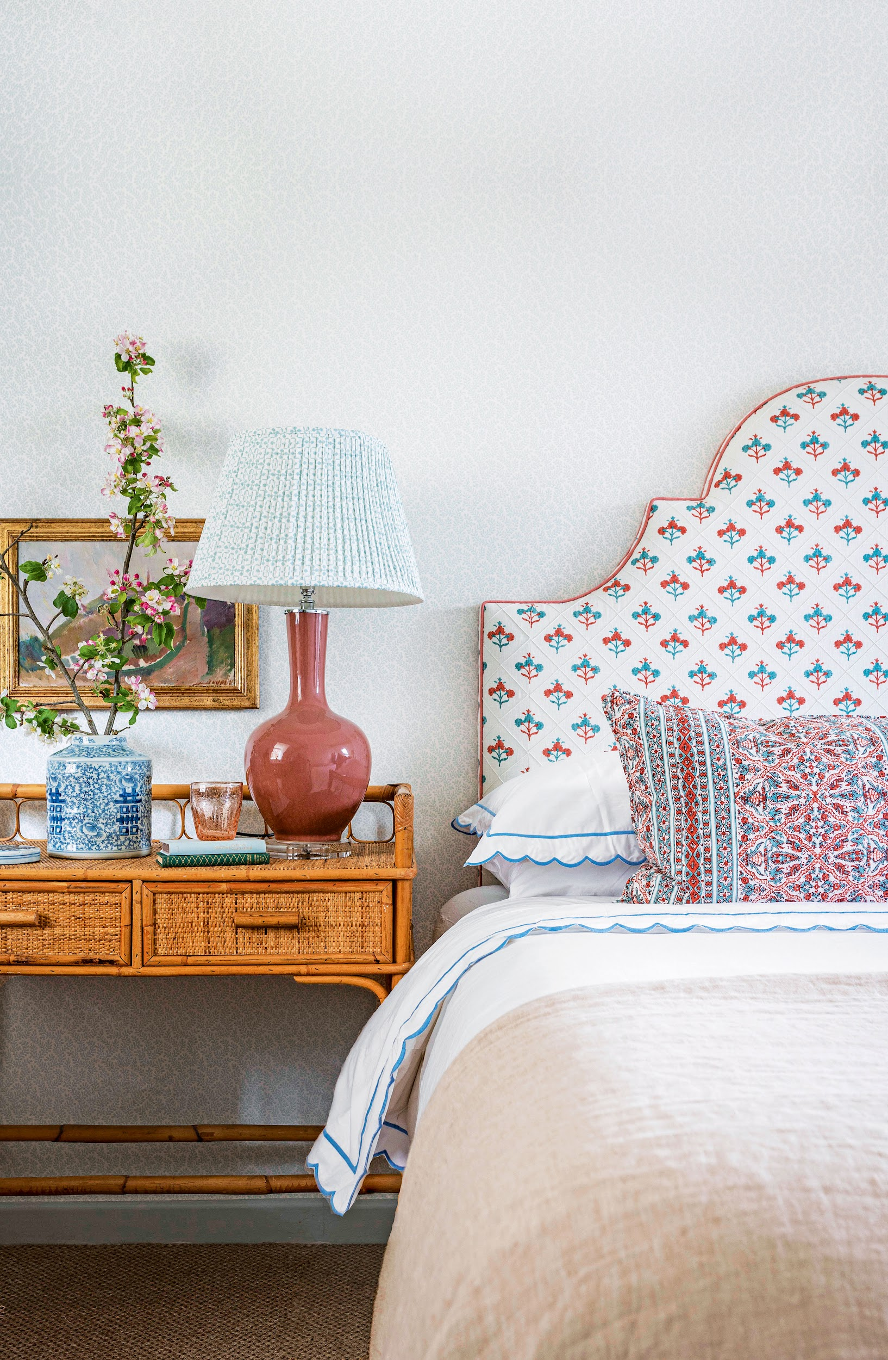
REACHING INTERIOR DESIGN AFICIONADOS
W I T H A P A S S I O N F O R C O U N T R Y L I F E S T Y L E S A N D H O M E S
2.7X Our Country Homes & Interiors audience are 2.7X more likely than the UK average to have a second home
77% of our Country Homes & Interiors audience are always looking for new was to improve their homes
£166M total yearly expenditure on DIY, decorating and home improvement by our Country Homes & Interiors audience
Source: TGI, April 2025

Slide 4
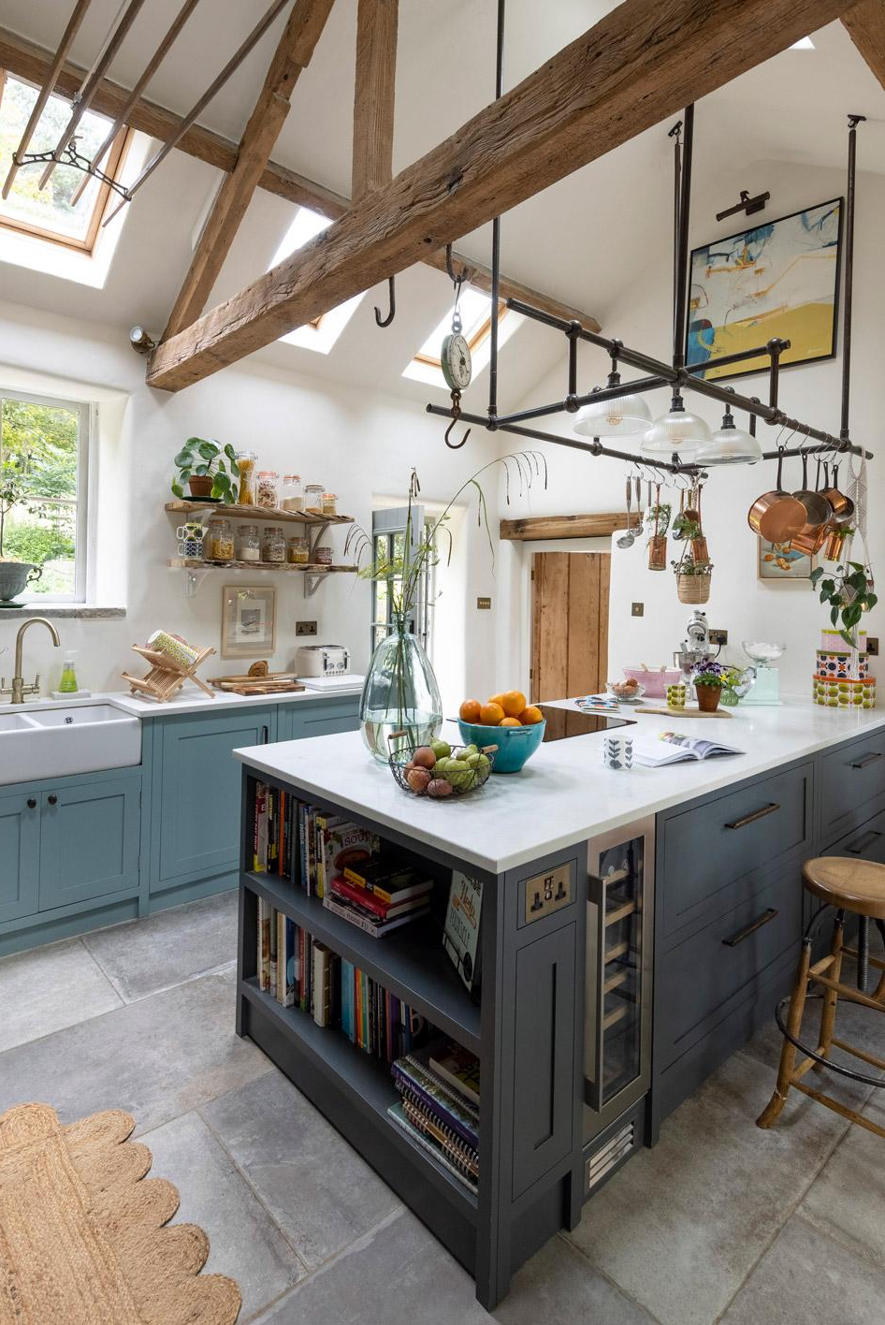

3X
More likely than the UK average to earn over £75k per annum
Life in the country has changed, and the new look Country Homes & Interiors captures that fresh and exciting style and spirit. We've packed it with inspiration and ideas that bring a new perspective on homes, interiors and gardens, for rural dwellers and dreamers.
Country Homes & Interiors is the only country magazine with home at its heart. It has been redesigned with a new logo and fresh look to capture the essence of modern country style today. Discover beautifully renovated rustic properties and contemporary builds; colourful, curated decorating and the best interior design ideas; glorious gardens and expert tips on how to make them bloom; and all the moments that make being in the countryside so special.
57%
ABC1
62%
Female
2.6M
44.8K
279K
42%
Total Social Reach
ABC Circulation
Average issue readership
35-54
Source: ABC Circulation, Jan-Dec 2024; Total Social Reach, October 2024; TGI GB, October 2024.
Notes:
Country Homes

Slide 5
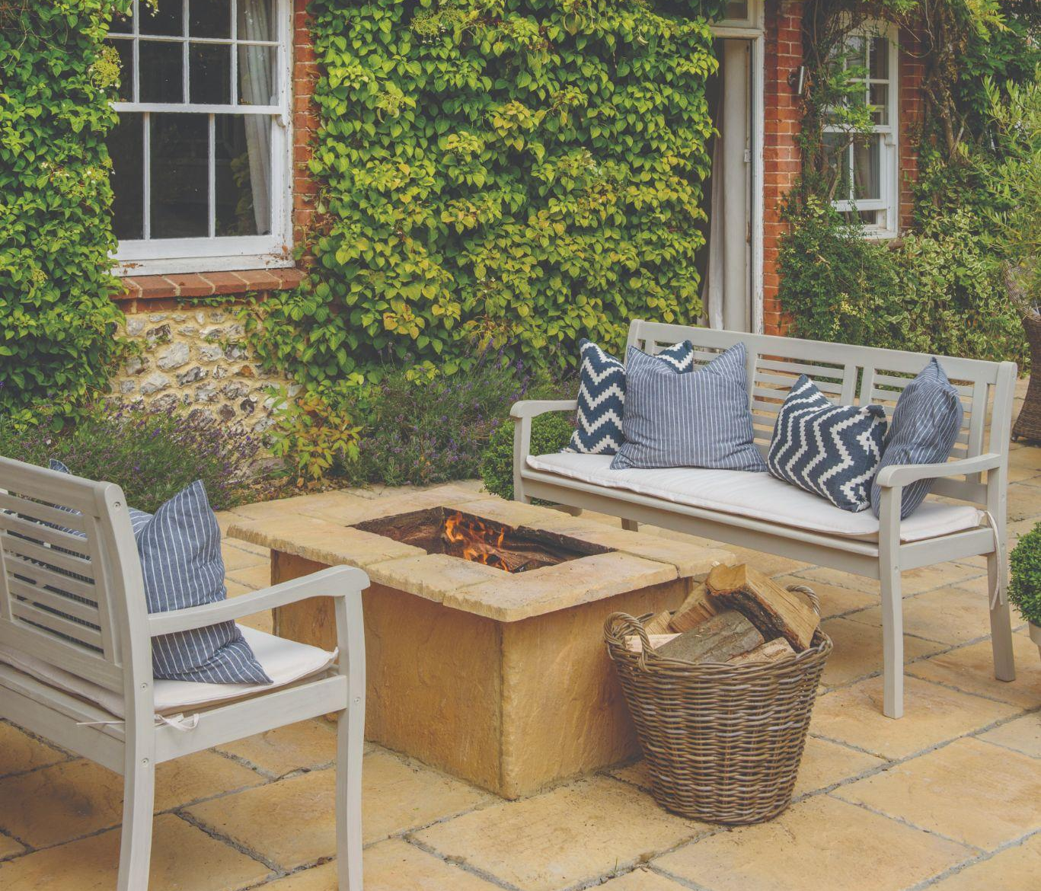
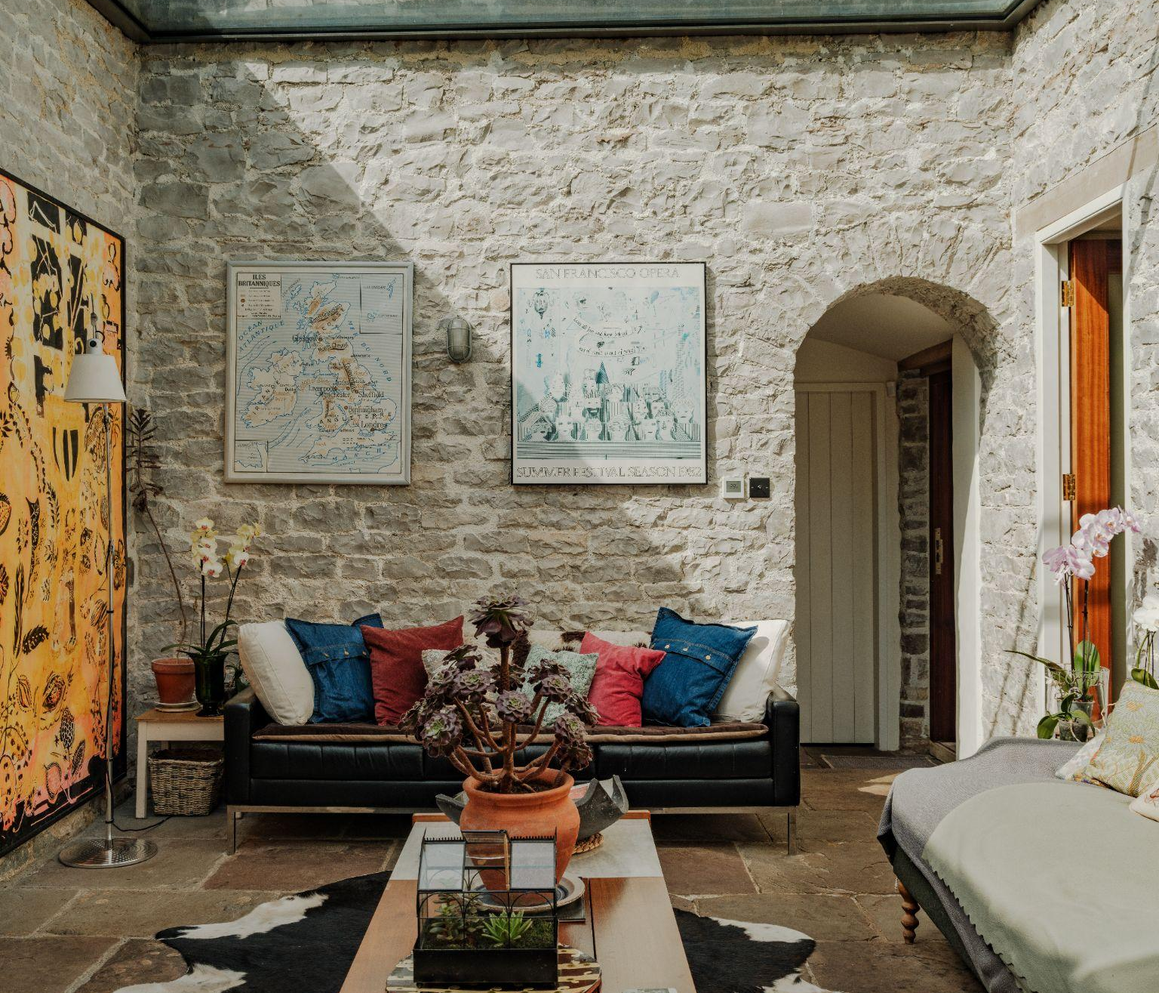
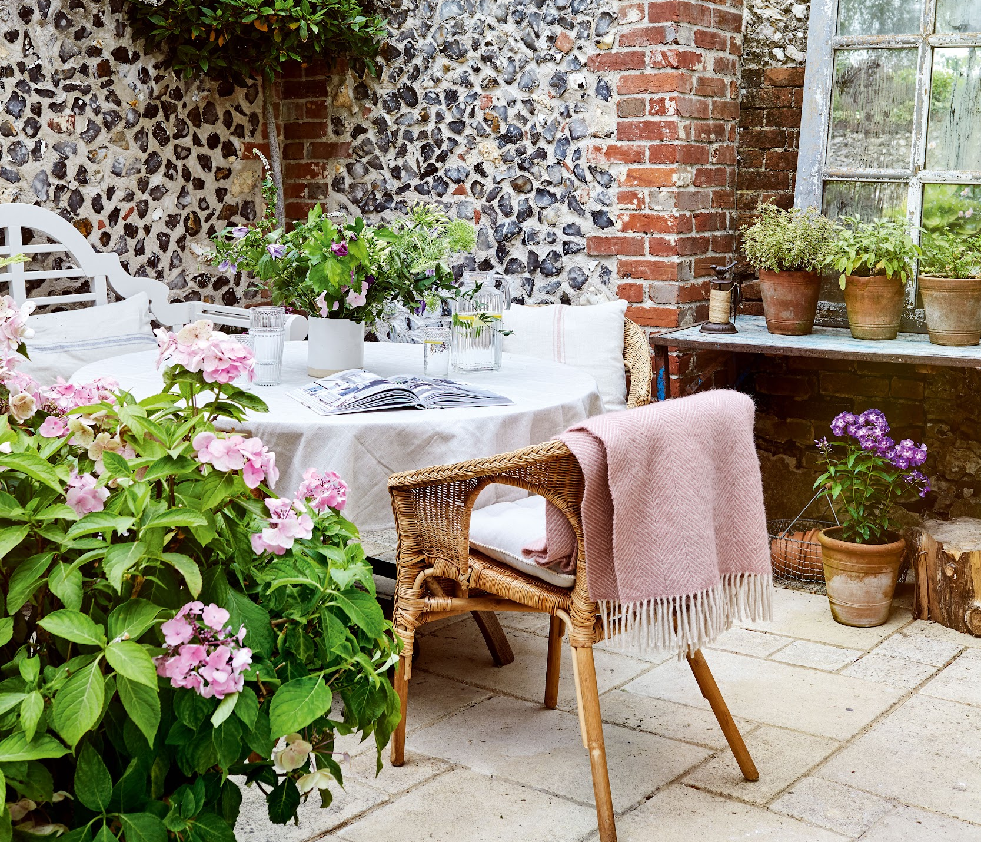
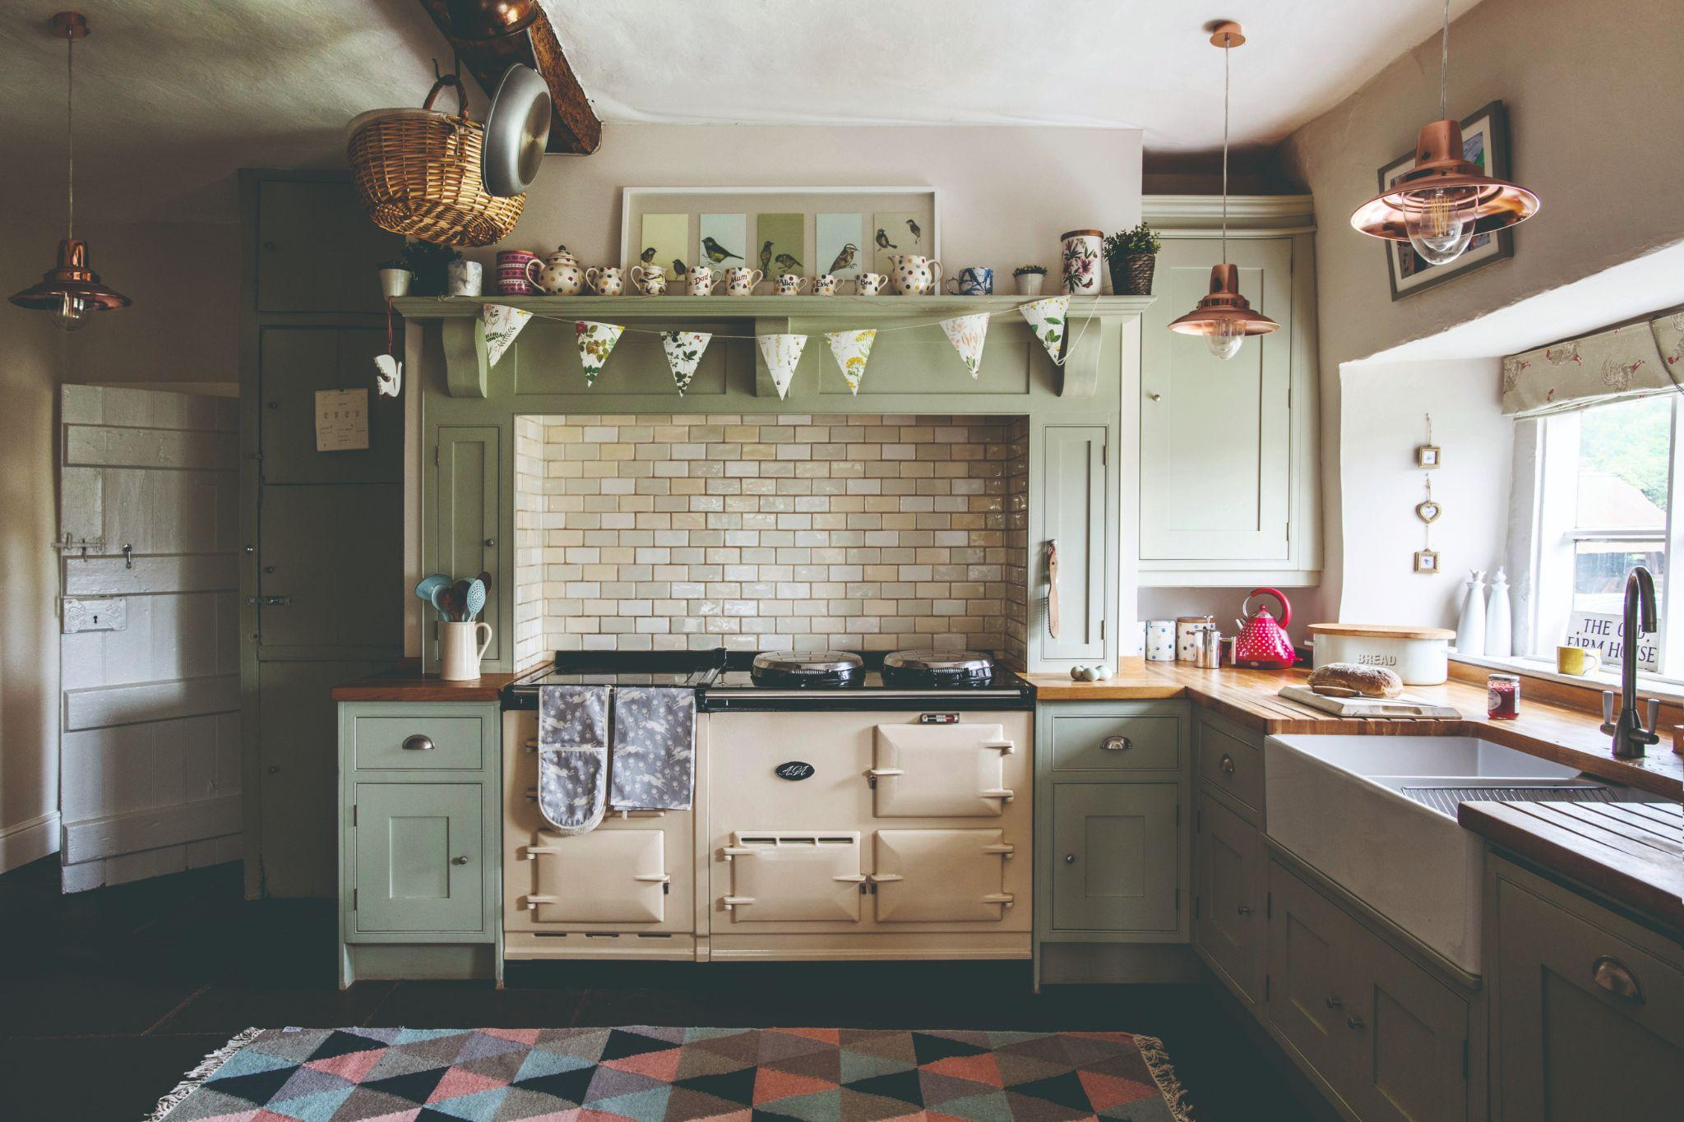
ADVERTISING OPPORTUNITIES
TO GET INVOLVED, PLEASE CONTACT US
PAPER WRAPS &
FEATURE DOMINATION
FULL PAGE ADVERTORIALS
&
DOUBLE PAGE SPREAD ADVERTORIALS
HIGH IMPACT DISPLAY AND DOUBLE PAGE SPREADS
SOCIAL AMPLIFICATION PACKAGES

Slide 6
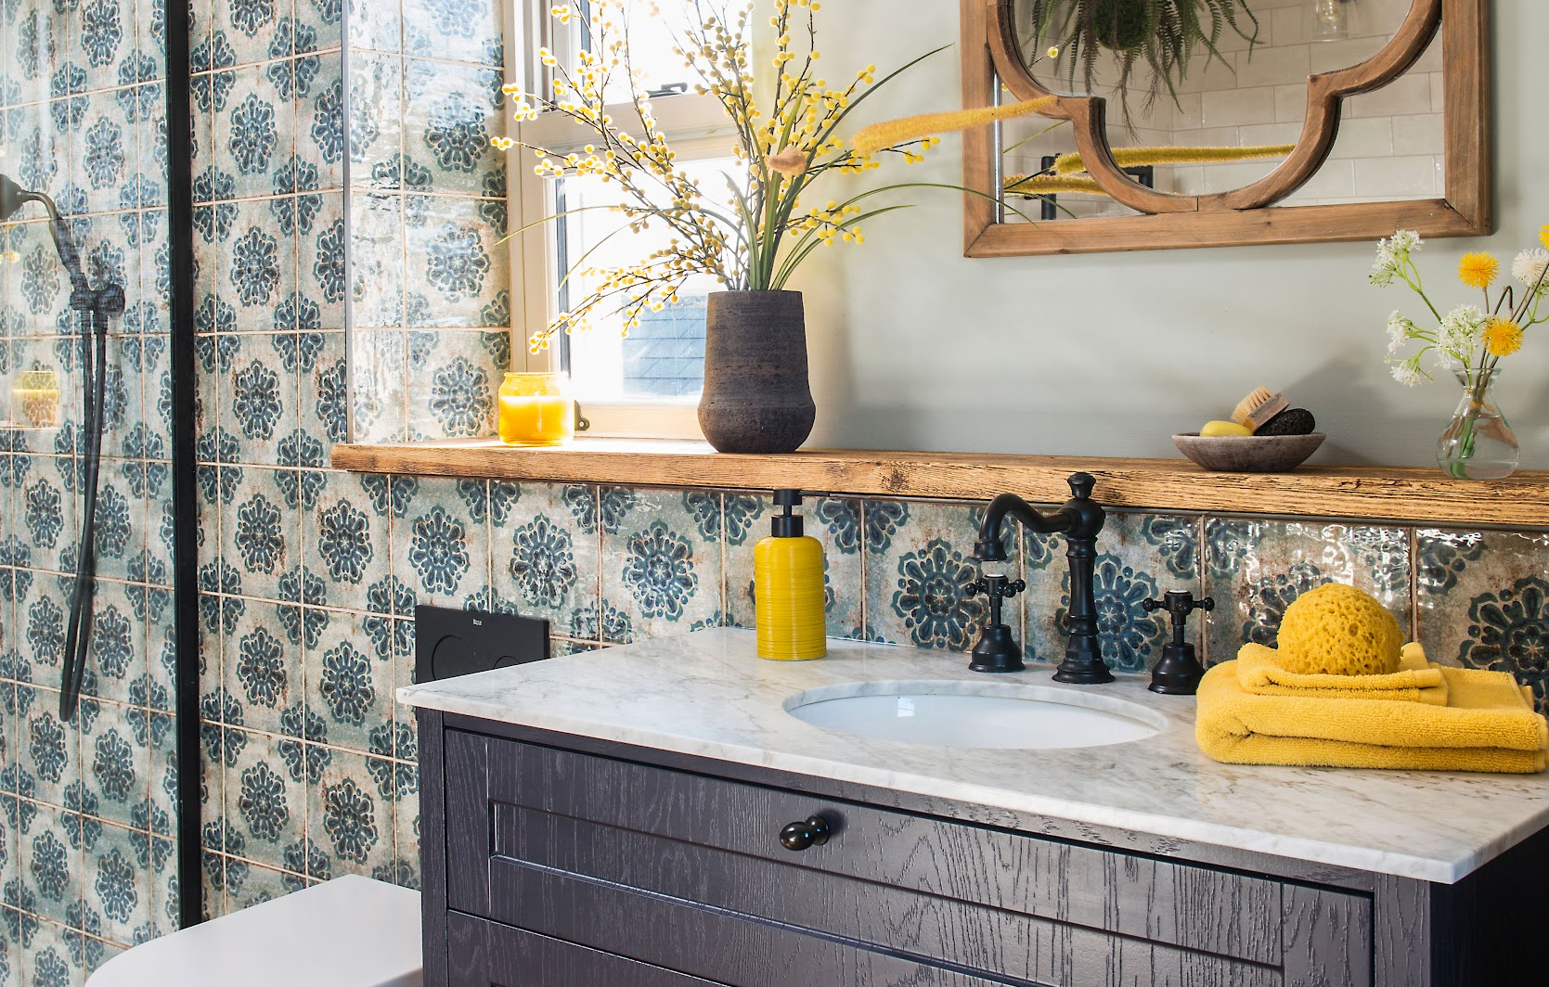
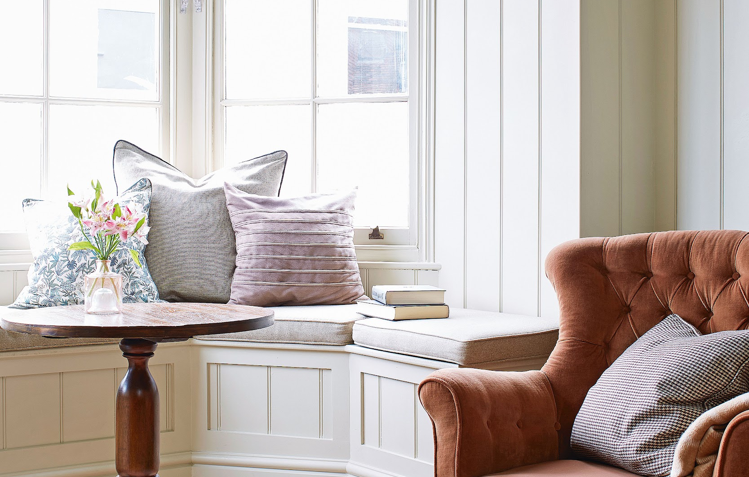
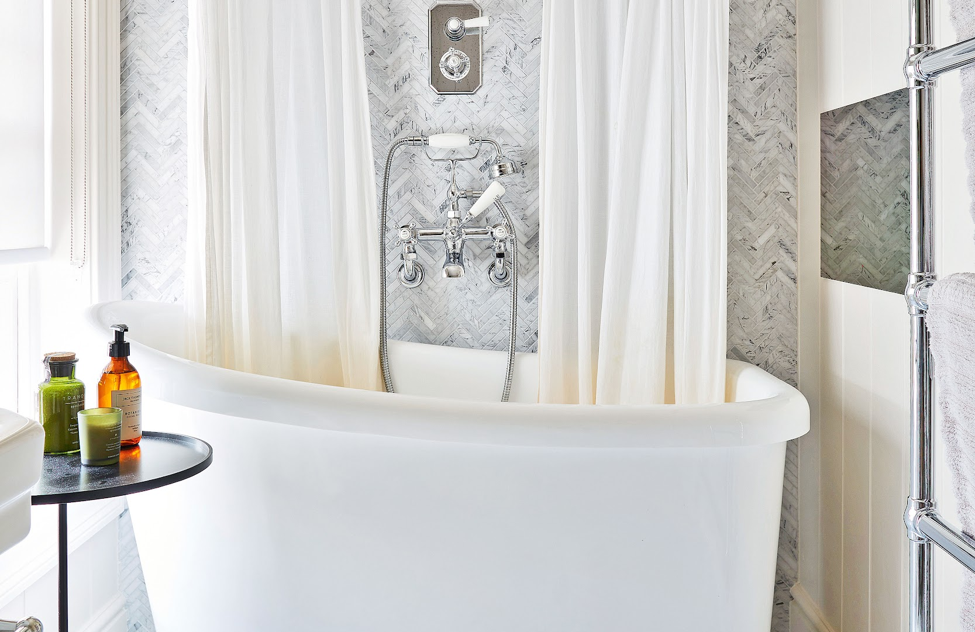
GROW YOUR BRAND WITH
COUNTRY HOMES & INTERIORS
CHOICE
TRUST
GROWTH
Our Country Homes & Interiors audience are 4.4X more likely than the UK average use magazine advertising as a way help them choose what to buy
Our audience are 2.2X more likely than the UK average to trust adverts in magazines the most
Brand recommendation grows by
+35% on average with Future homes campaigns
Source: TGI, April 2025; *All numbers are averages from Future’s 2021 - 2022 campaigns and partnerships in the homes category, £100k+, UK

Slide 7
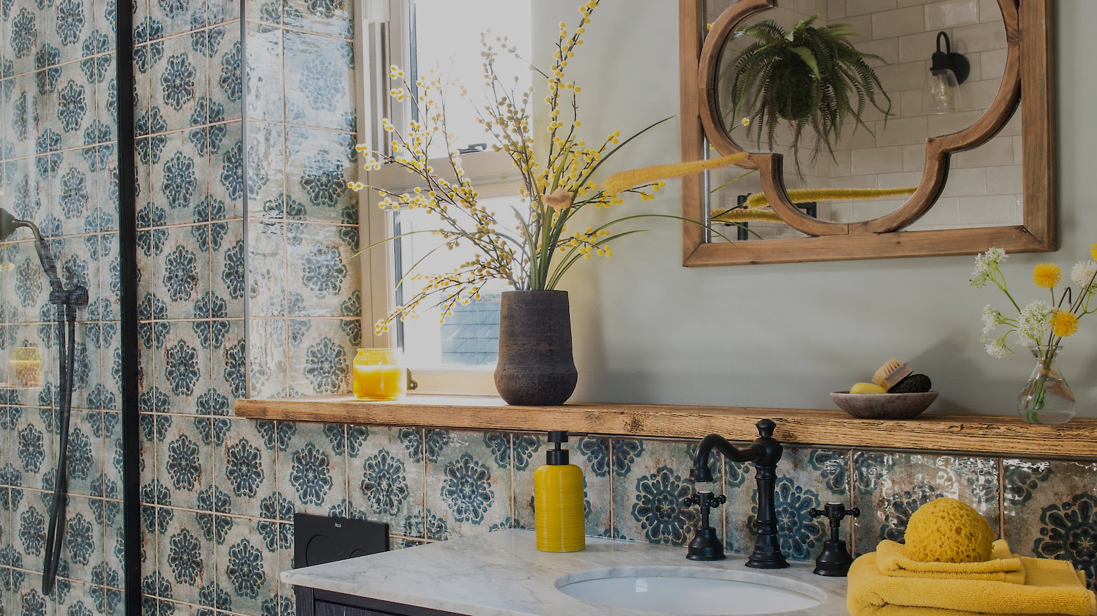
CONTENT CALENDAR 2025
JAN 25
DEC 24
FEB 25
JAN 25
MAR 25
FEB 25
APR 25
MAR 25
MAY 25
APR 25
JUN 25
MAY 25
Slow and cosy Christmas
Wellness at home
Craft
Heating
Bathroom special and LOVE issue
Bathroom trends/makeovers
Windows
Small spaces issue
Small homes
storage ideas
Decluttering
Skye travel special
Easter
Entertaining
Spring Decor
Colour and Pattern Issue
How to use colour
How to use pattern
Paint special
Outdoor Living
Patios/terraces
garden heating & lighting
West Coast Ireland travel special
JUL 25
JUN 25
SEP 25
AUG 25
AUG 25
JUL 25
OCT 25
SEP 25
NOV 25
OCT 25
DEC 25
NOV 25
JAN 25
DEC 25
Staycation Cover Shoot
Summer decor & style reset
Outdoor cooking/living
summerhouses
Coastal Issue
Coastal trends
Food
houses
Decor Trends
Window Treatments
Best of British
Designer interviews
Homegrown materials - wood, wool, leather, etc
Kitchen Special
Cookware Shopping
Tableware
Dining rooms
Christmas
New Year / Christmas
Cover Date
Month On Sale
‹#›

Slide 8
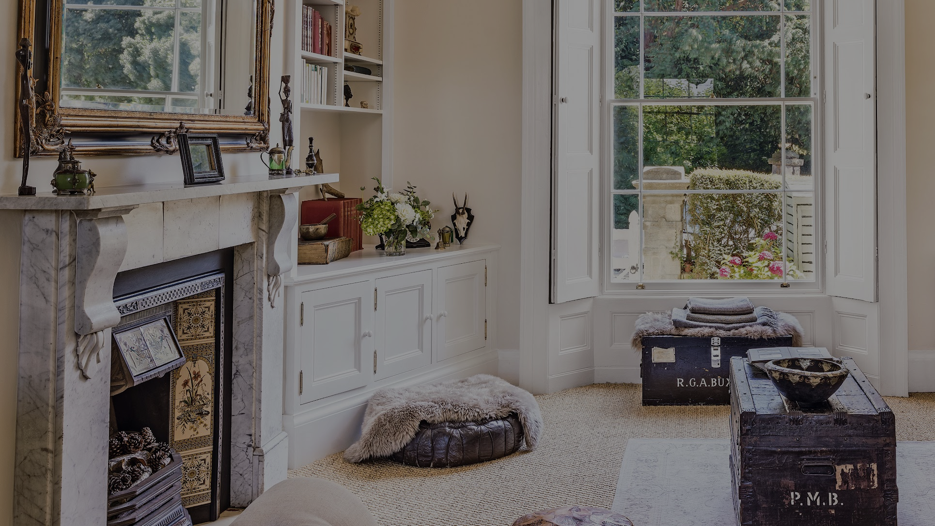
THANK YOU
For information on how to partner with us, please get in touch: Lucinda Clarke - lucinda.clarke@futurenet.com

