Slide 1



M E D I A P A C K
Notes:
Cover, outdoors,

Slide 2


Every issue features uniquely charming real homes with timeless style – from picture-postcard cottages, classic Georgian farmhouses, and elegant Edwardian villas to Victorian terraces. The fascinating homeowner stories and beautiful photography offer endless inspiration for readers. We advise how to correctly maintain and sympathetically renovate period properties, and blend old and new with flair and originality. Readers will find design ideas for projects large or small, whether they are planning a full-scale renovation or a small decoration update. We showcase the latest wallpapers, fabrics, paints, furnishings and accessories that complement a period home, championing the best British heritage brands and independent designer-makers, and advise where to source antiques and vintage. Our readers also love their gardens and the traditional real gardens we showcase, along with expert advice on plant selection, garden design and products for outdoor living offer inspiration for perfecting their schemes so that their period homes and gardens work in happy harmony.
Rachel Crow, Editor
P E R I O D L I V I N G I S B R I T A I N ' S O N L Y M A G A Z I N E C E L E B R A T I N G A N D F O C U S I N G O N P E R I O D H O M E S .

Slide 3
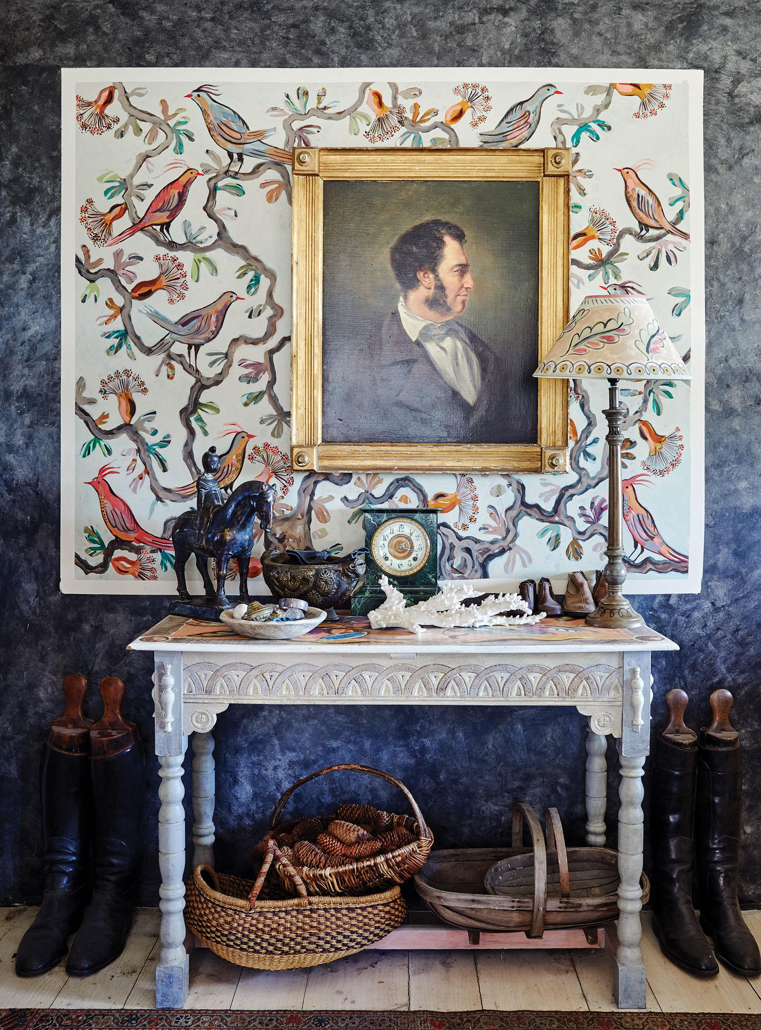


Period Living is the ultimate sourcebook
for timeless, classic and eclectic style.
It's the complete guide to decorating, renovating and maintaining a traditional property. Every issue delivers stylish real homes and gardens, decorating inspiration, shopping ideas, lifestyle content, and expert advice.
174.1K
27.5K
121K
Total social reach
ABC print circulation
Average issue readership
Source: Total Social Reach, February 2024; ABC Circulation, January - December 2023; TGI, April 2024
Notes:
Period Living

Slide 4
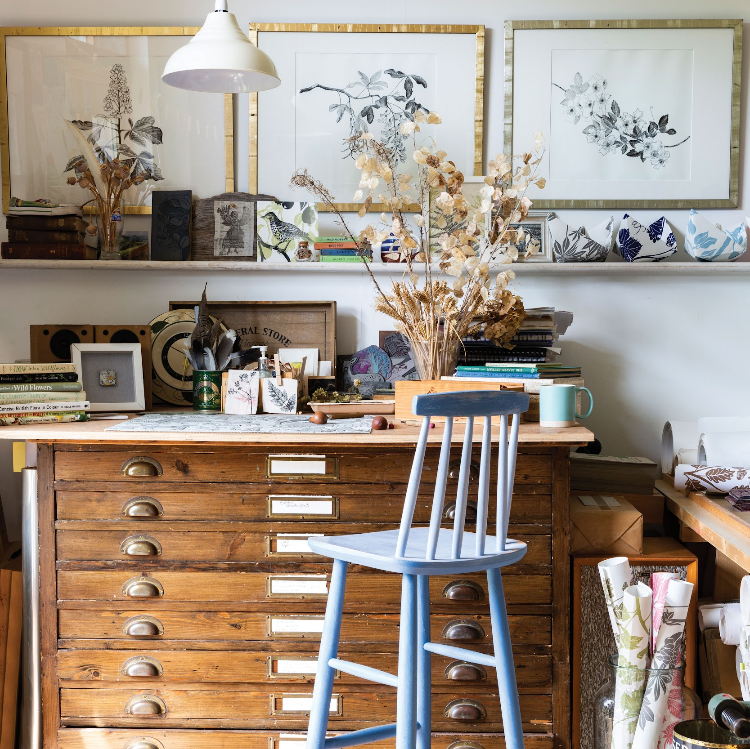
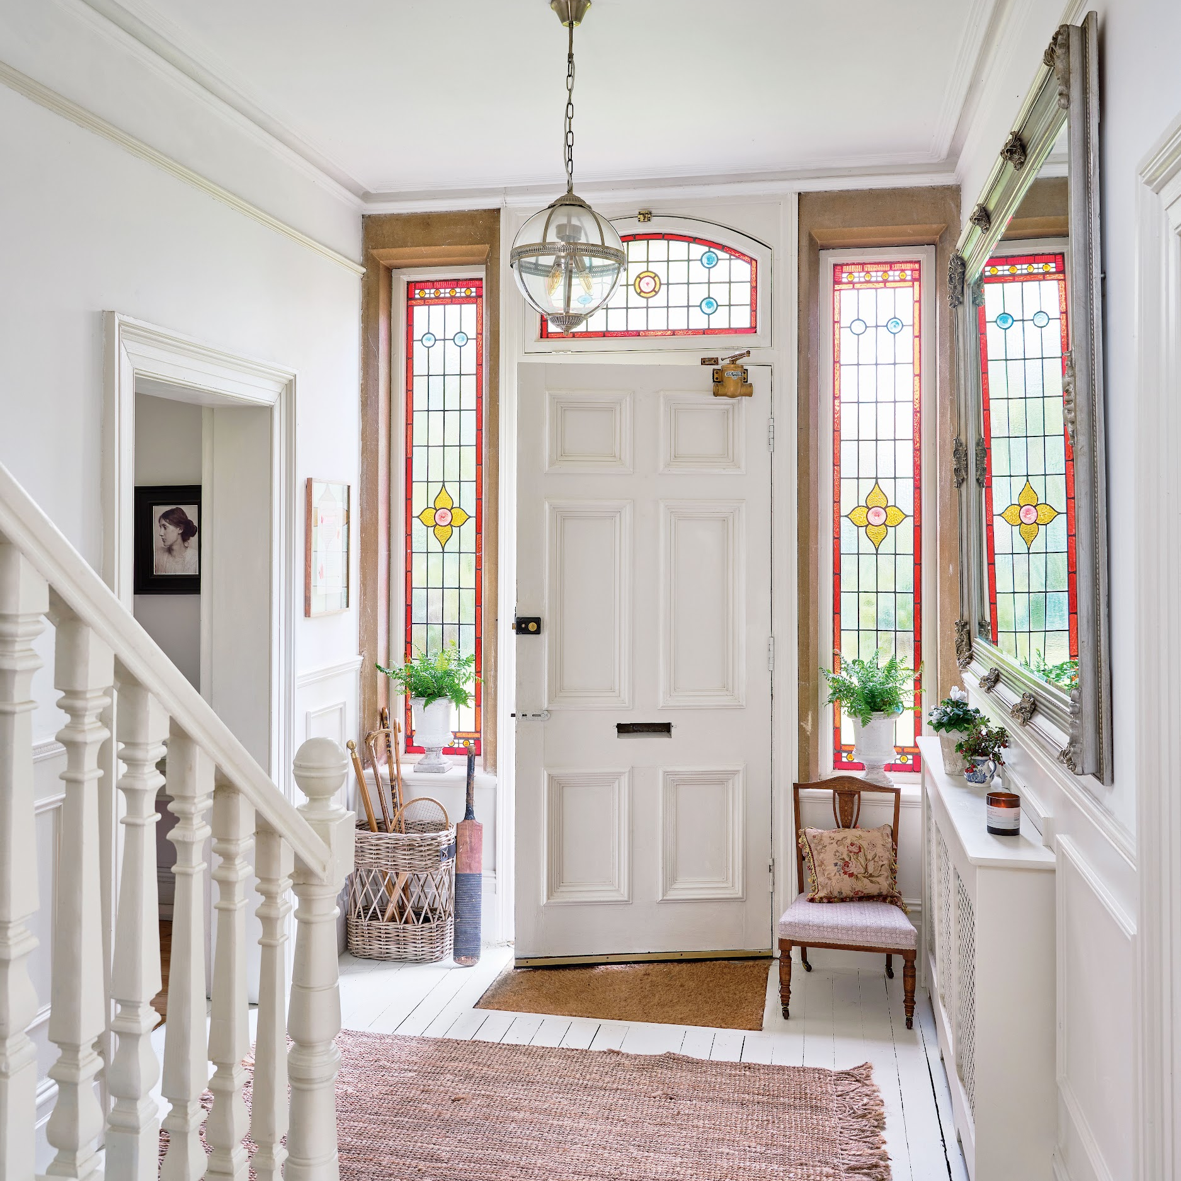
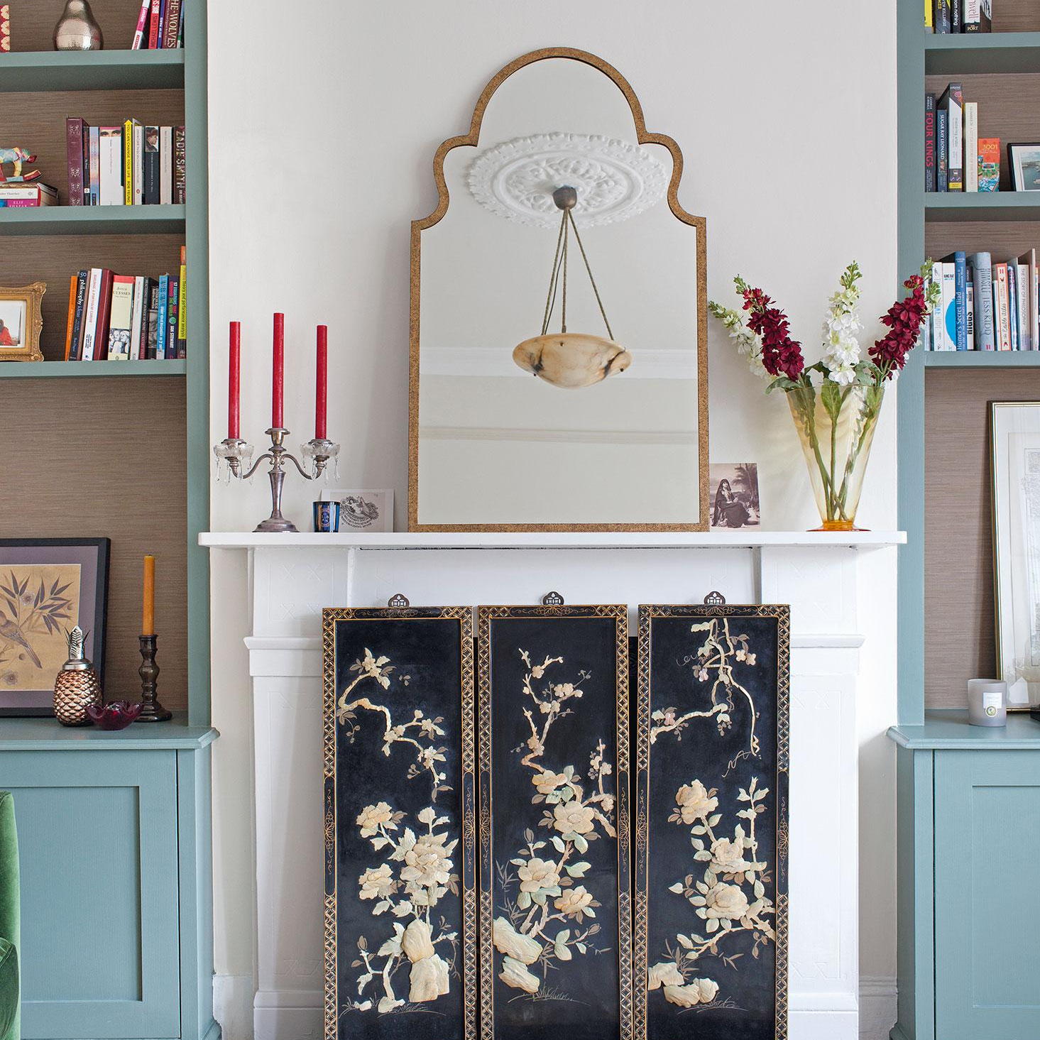
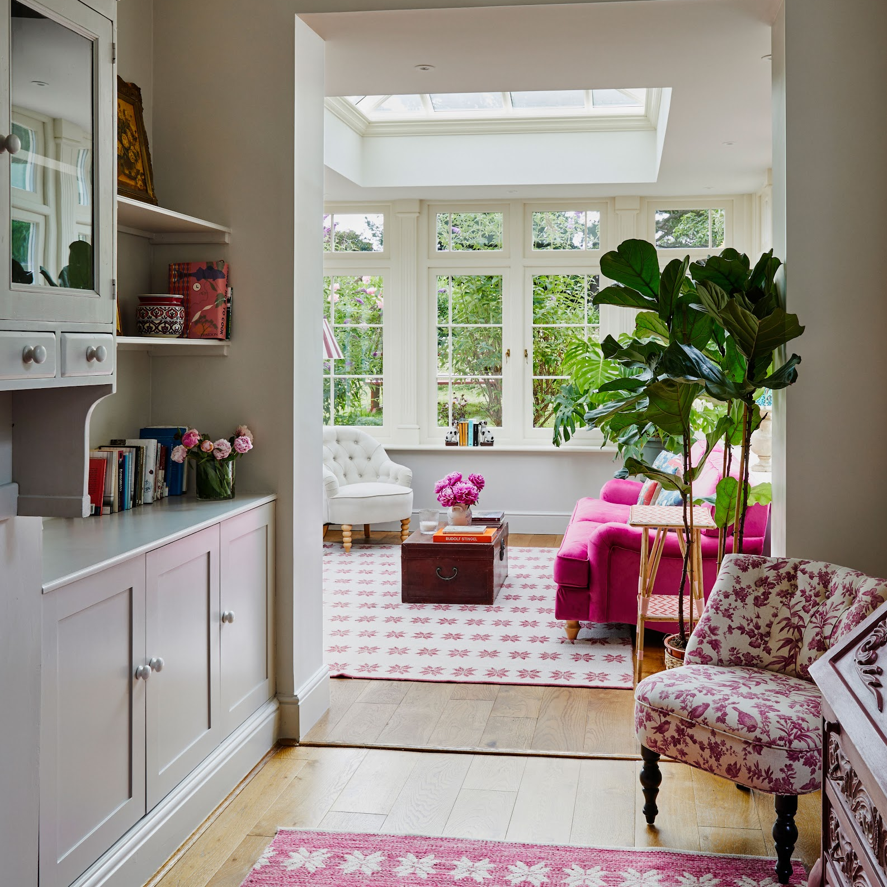
OUR VINTAGE HOME & DESIGN AUDIENCE
IN THE MARKET TO FULFILL THEIR PASSIONS
81%
+77%
£42M
£66K
Are always on the lookout for ways to improve their home
More likely than the UK average to be in the market for new furniture
Total yearly expenditure on DIY, decorating and home improvements
Average HHI
Source: TGI, April 2024

Slide 5
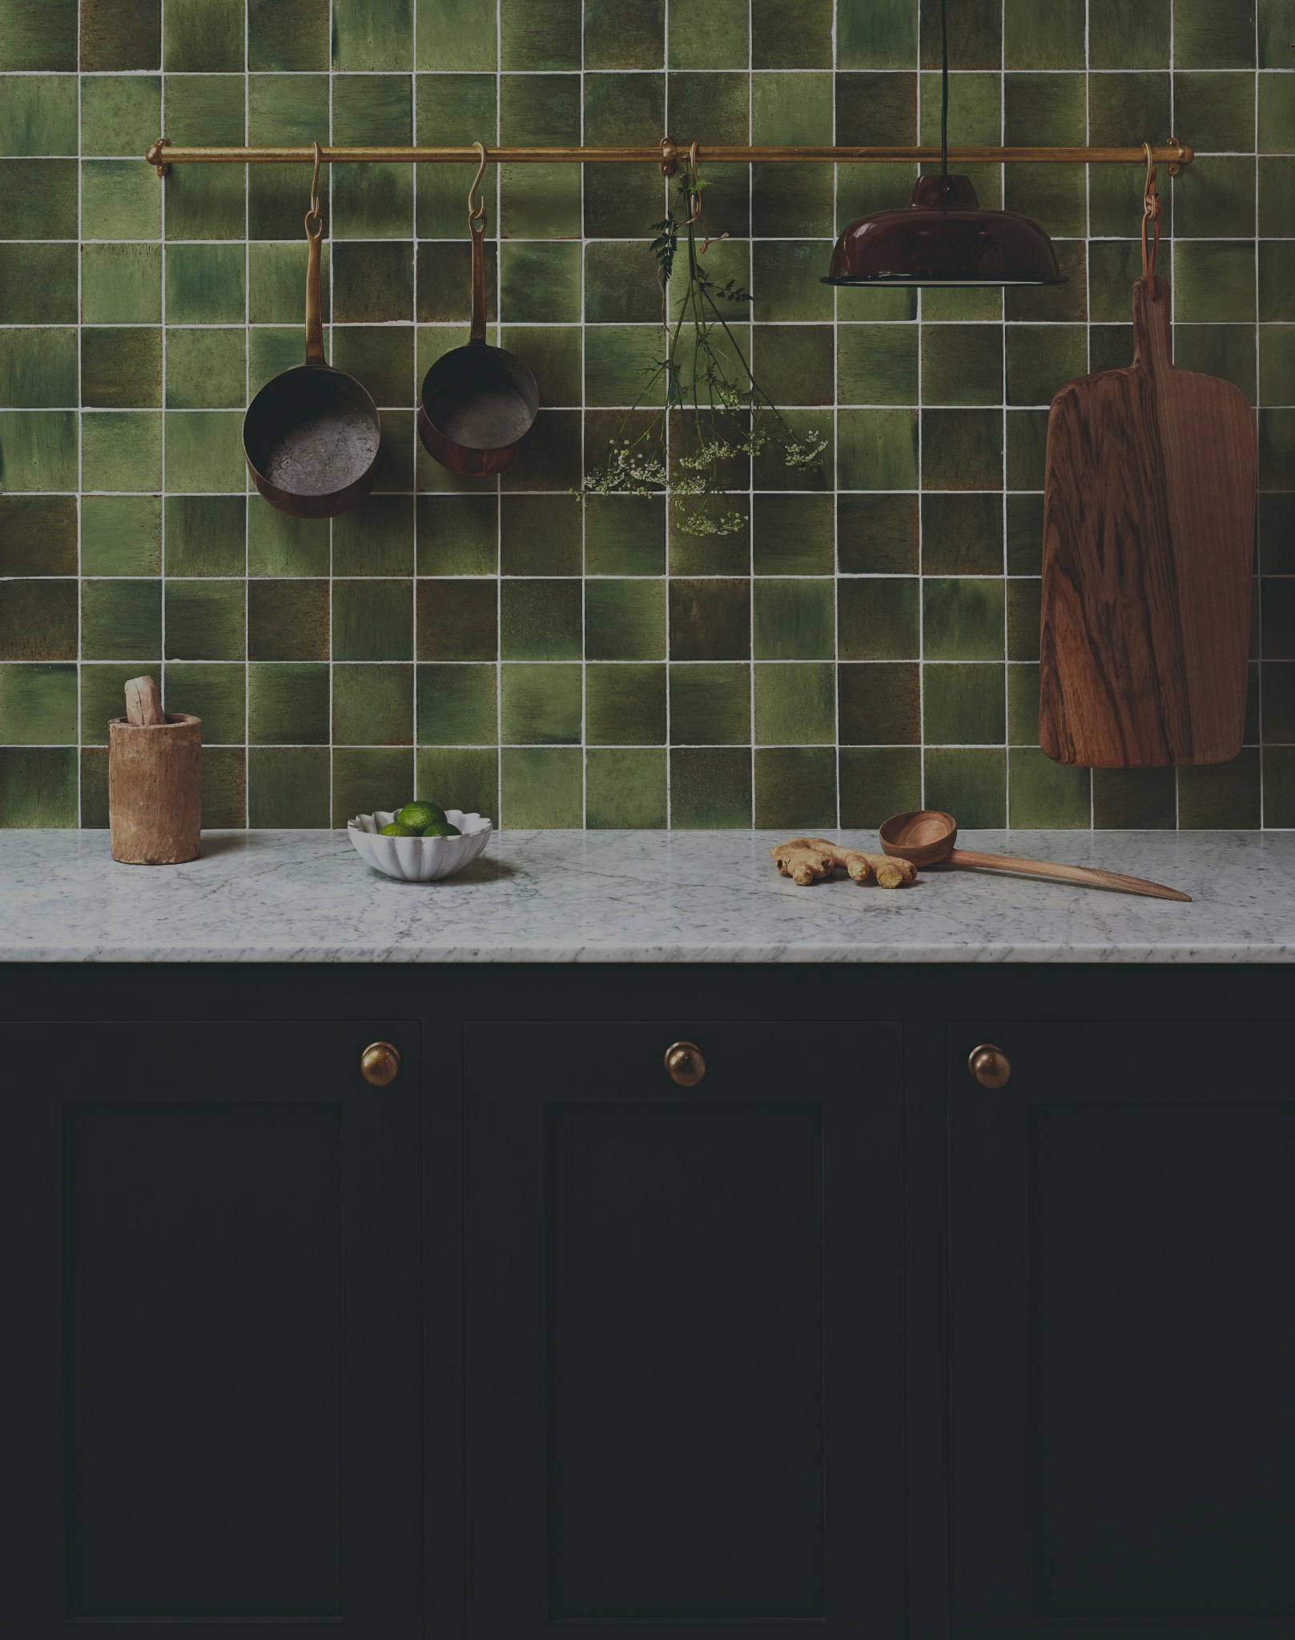


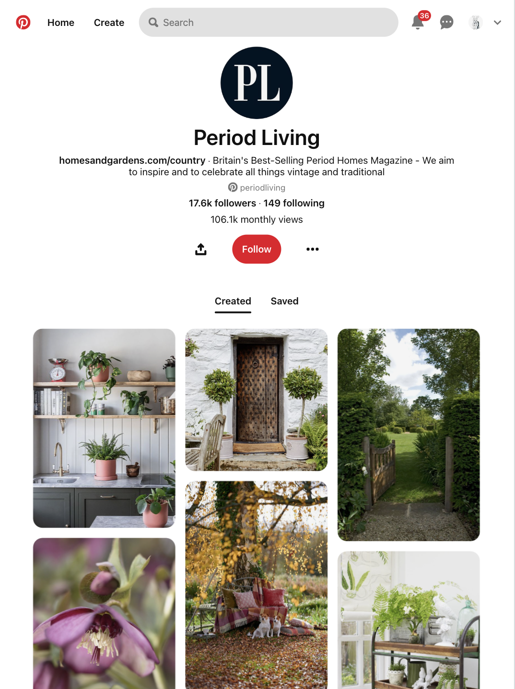


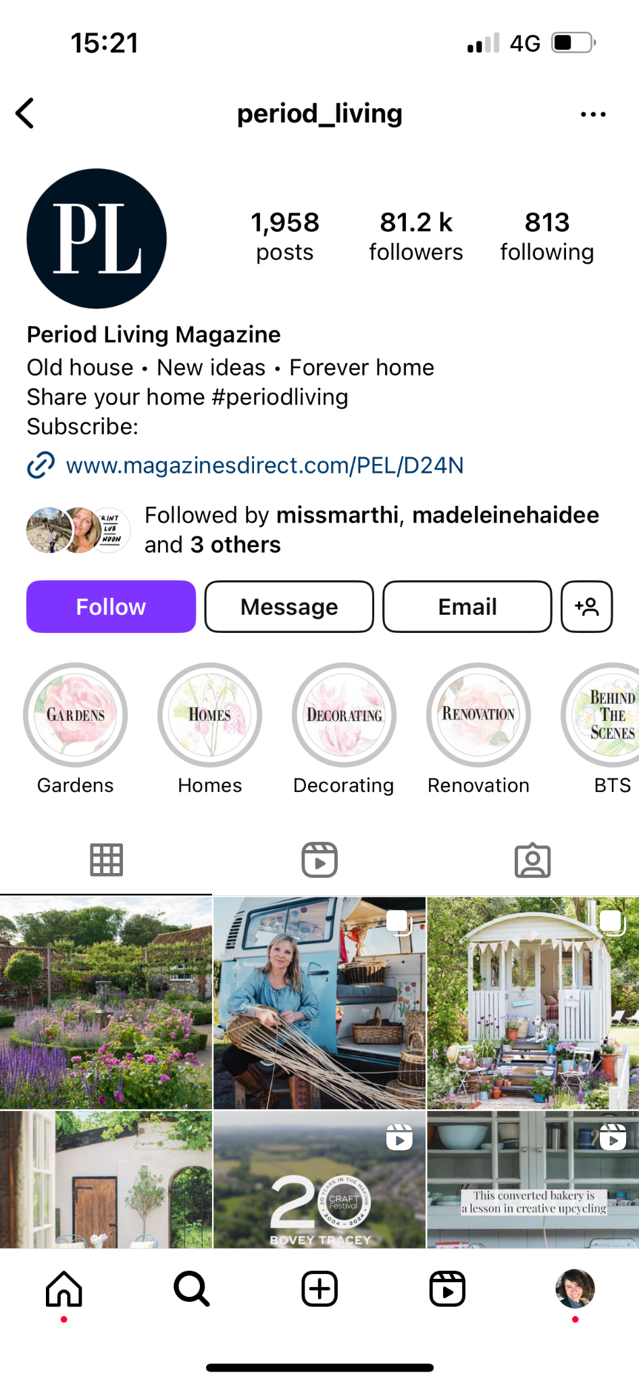
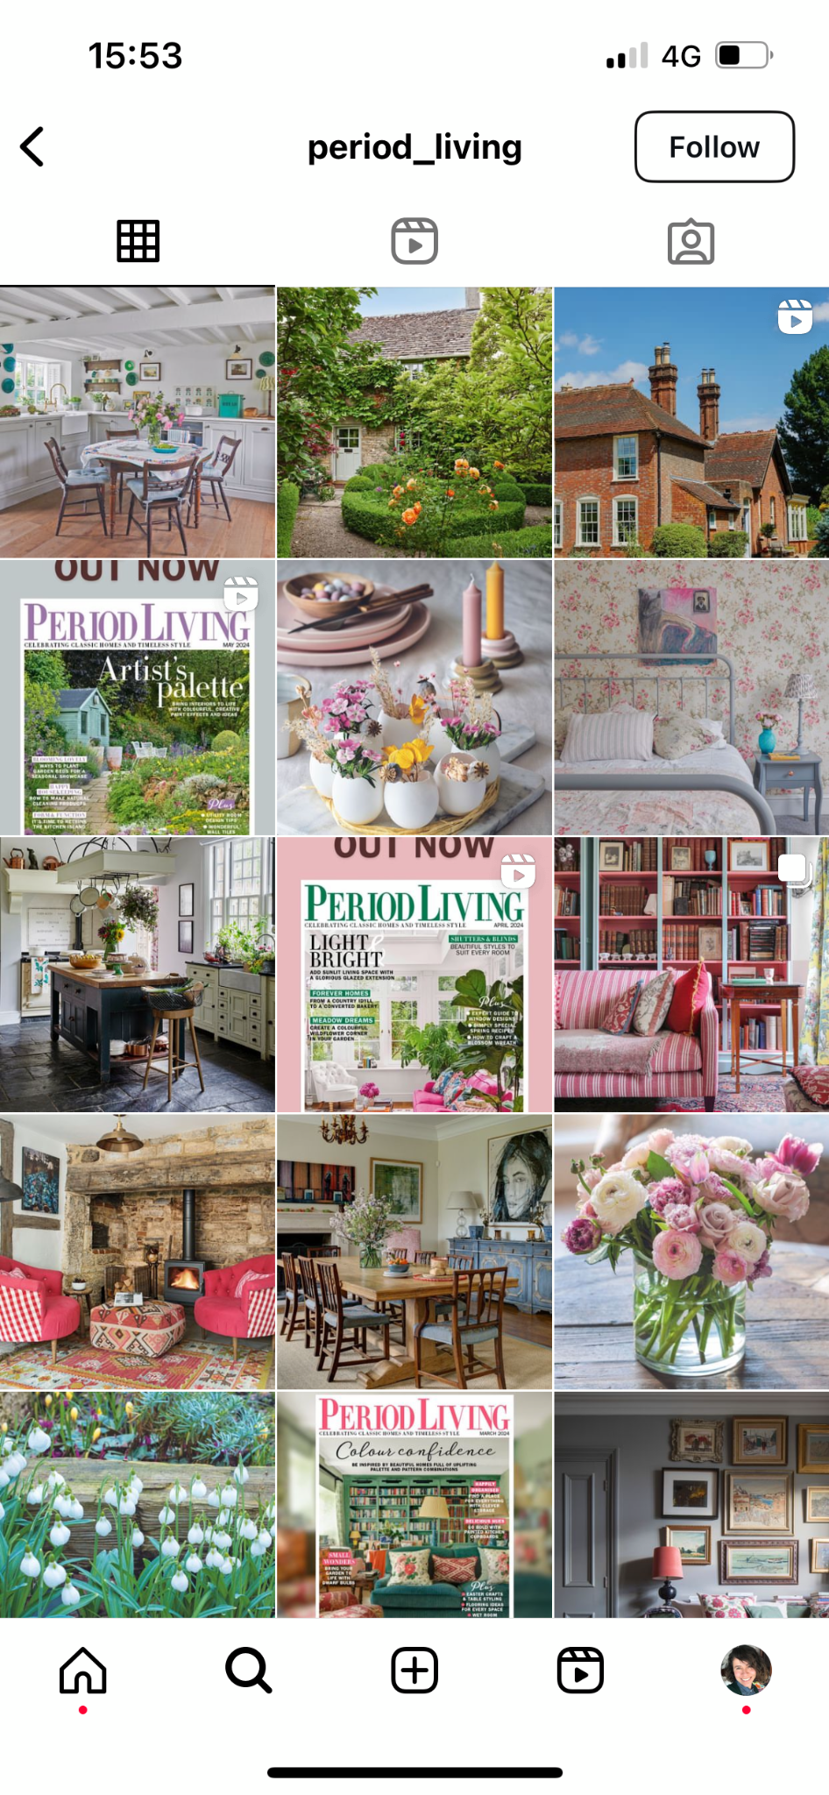

CREATING TIMELESS CONTENT, ENGAGING
LOYAL AUDIENCES

Slide 6

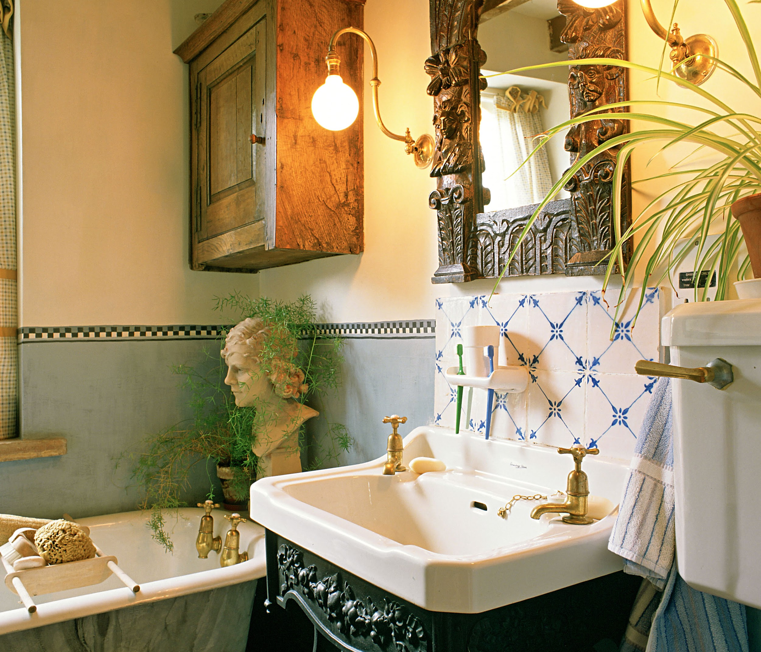
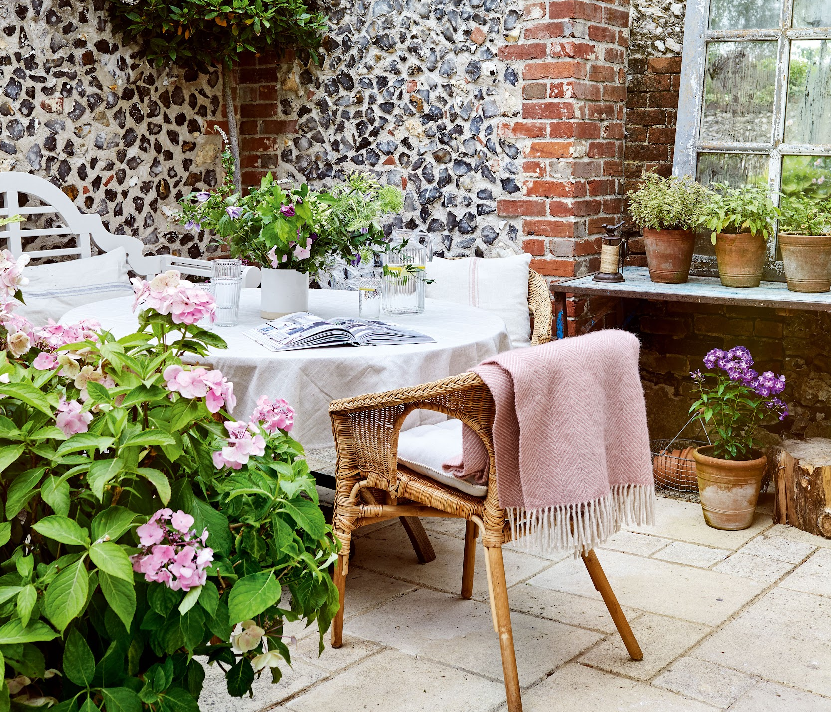
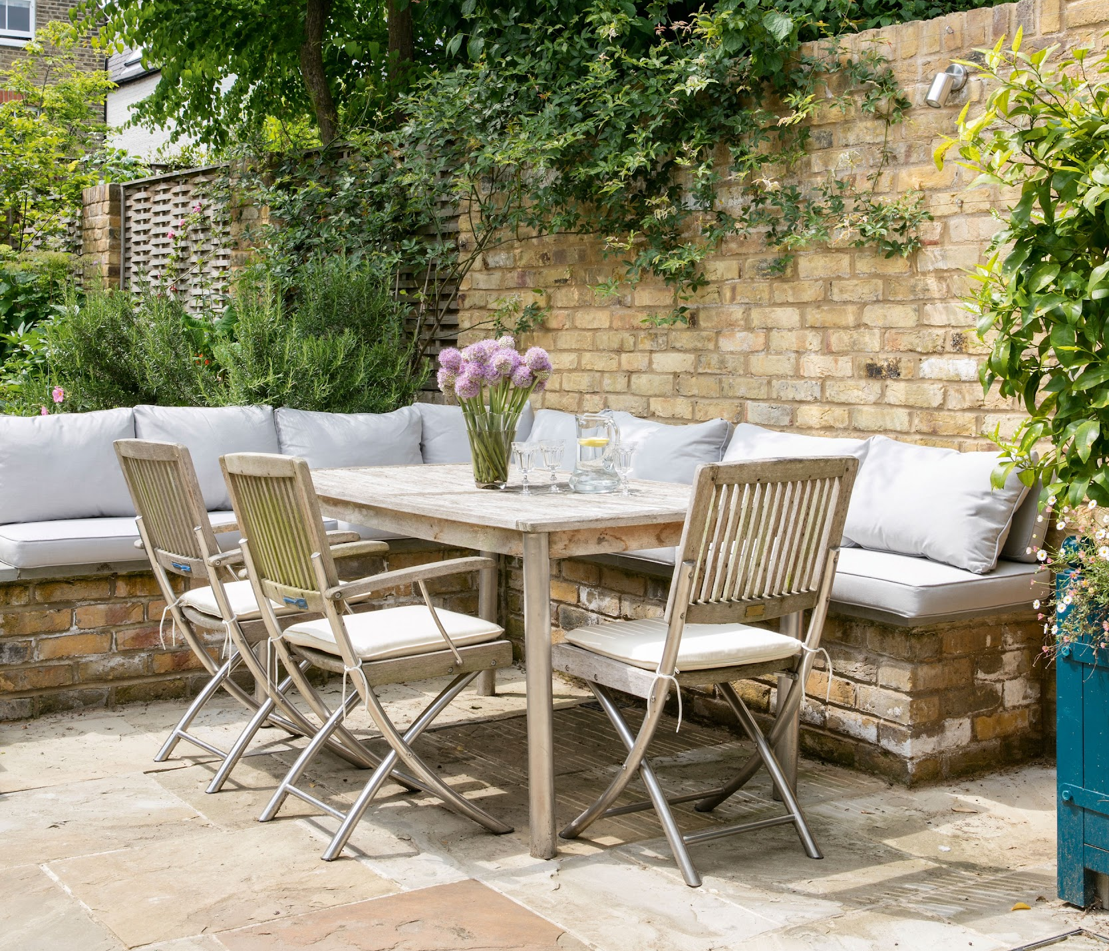
ADVERTISING OPPORTUNITIES
REACH OUR PASSIONATE AUDIENCE THROUGH PRINT AND SOCIAL
PAPER WRAPS &
FEATURE DOMINATION
FULL PAGE ADVERTORIALS
&
DOUBLE PAGE SPREAD ADVERTORIALS
HIGH IMPACT DISPLAY AND DOUBLE PAGE SPREADS
SOCIAL AMPLIFICATION PACKAGES
TO GET INVOLVED, PLEASE CONTACT US

Slide 7
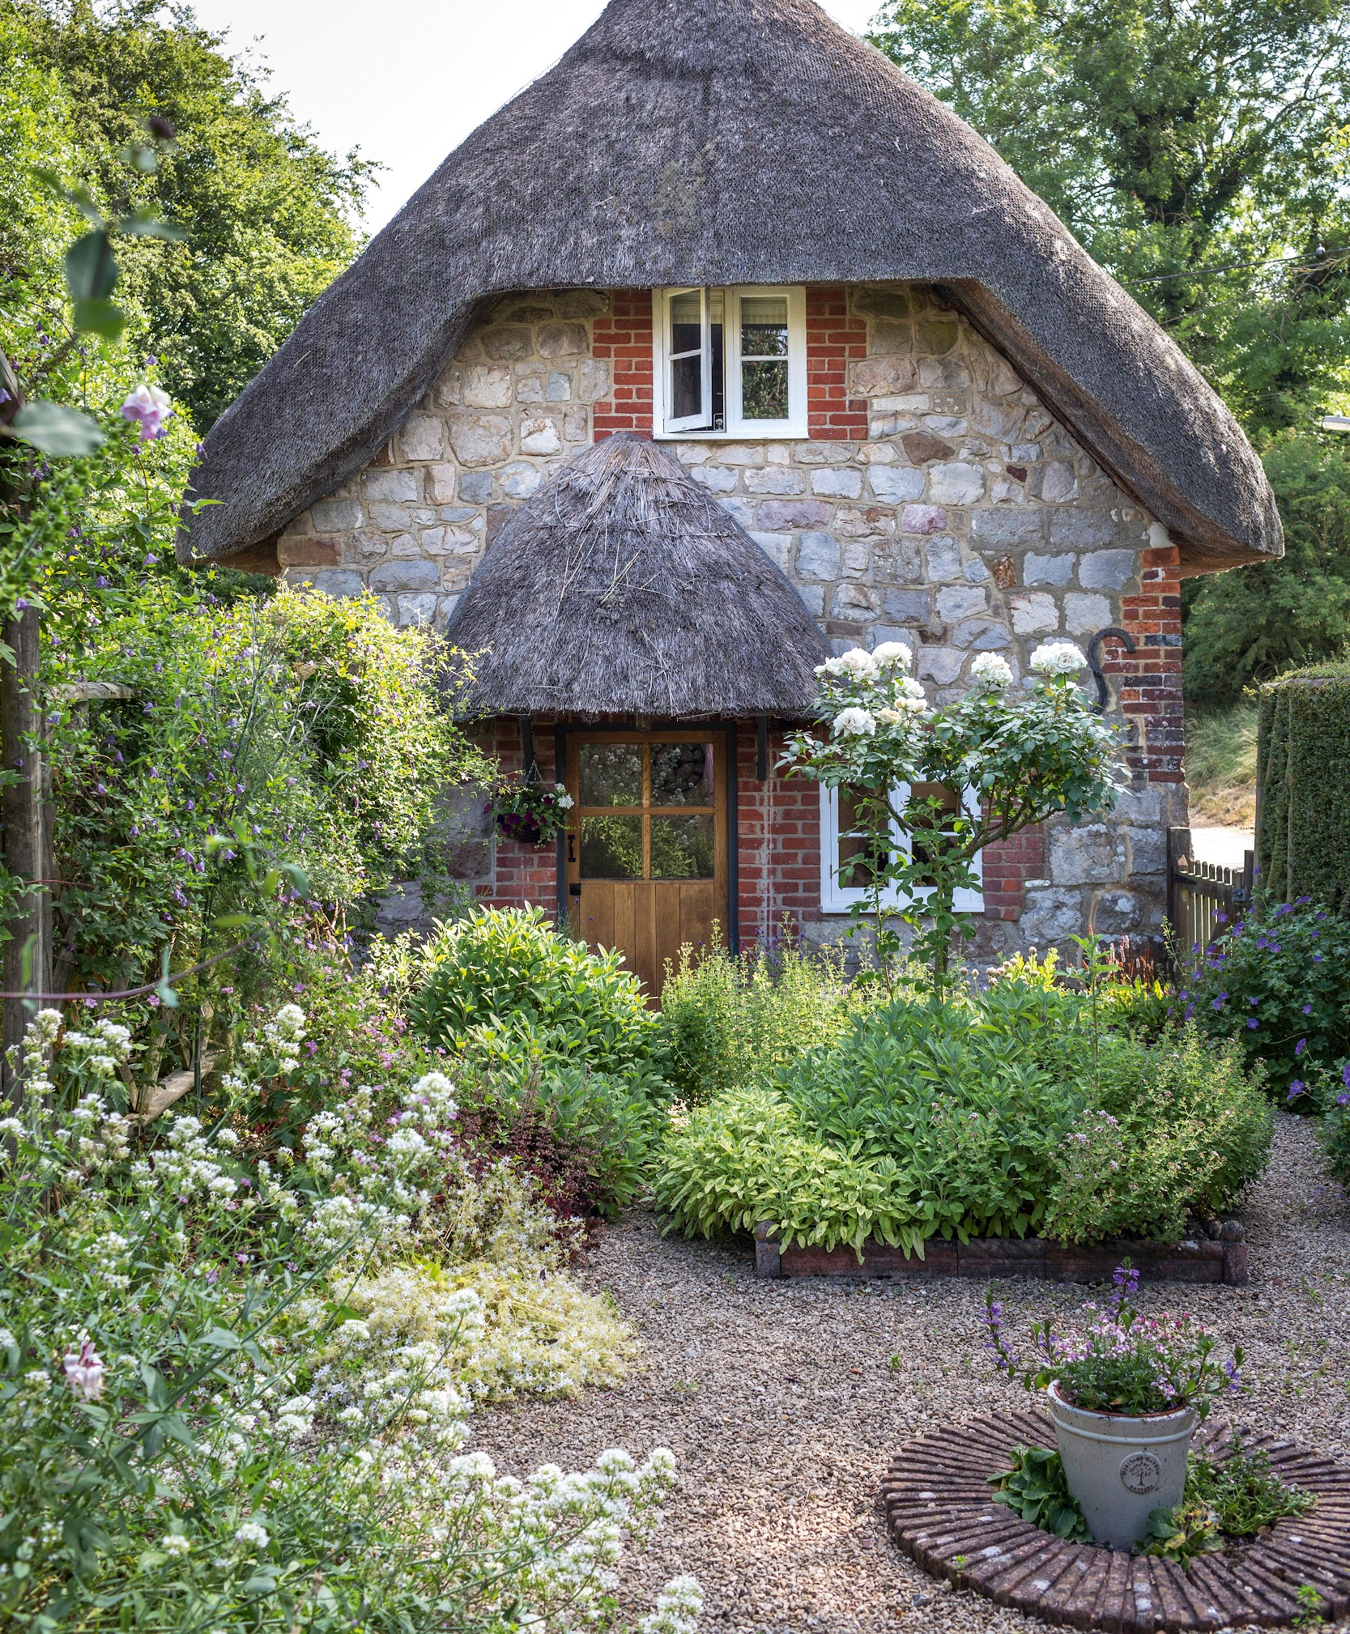
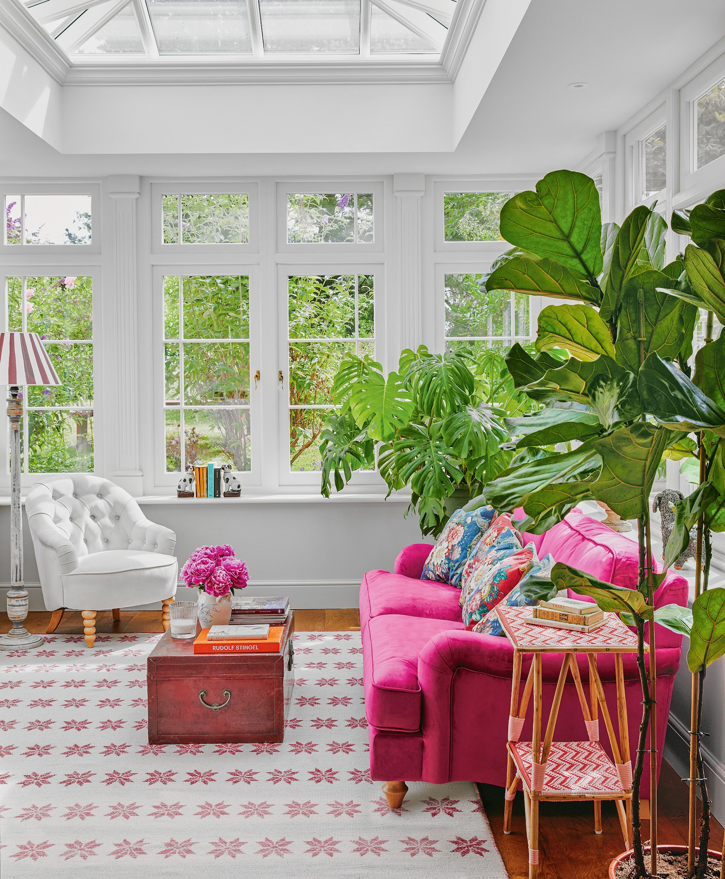
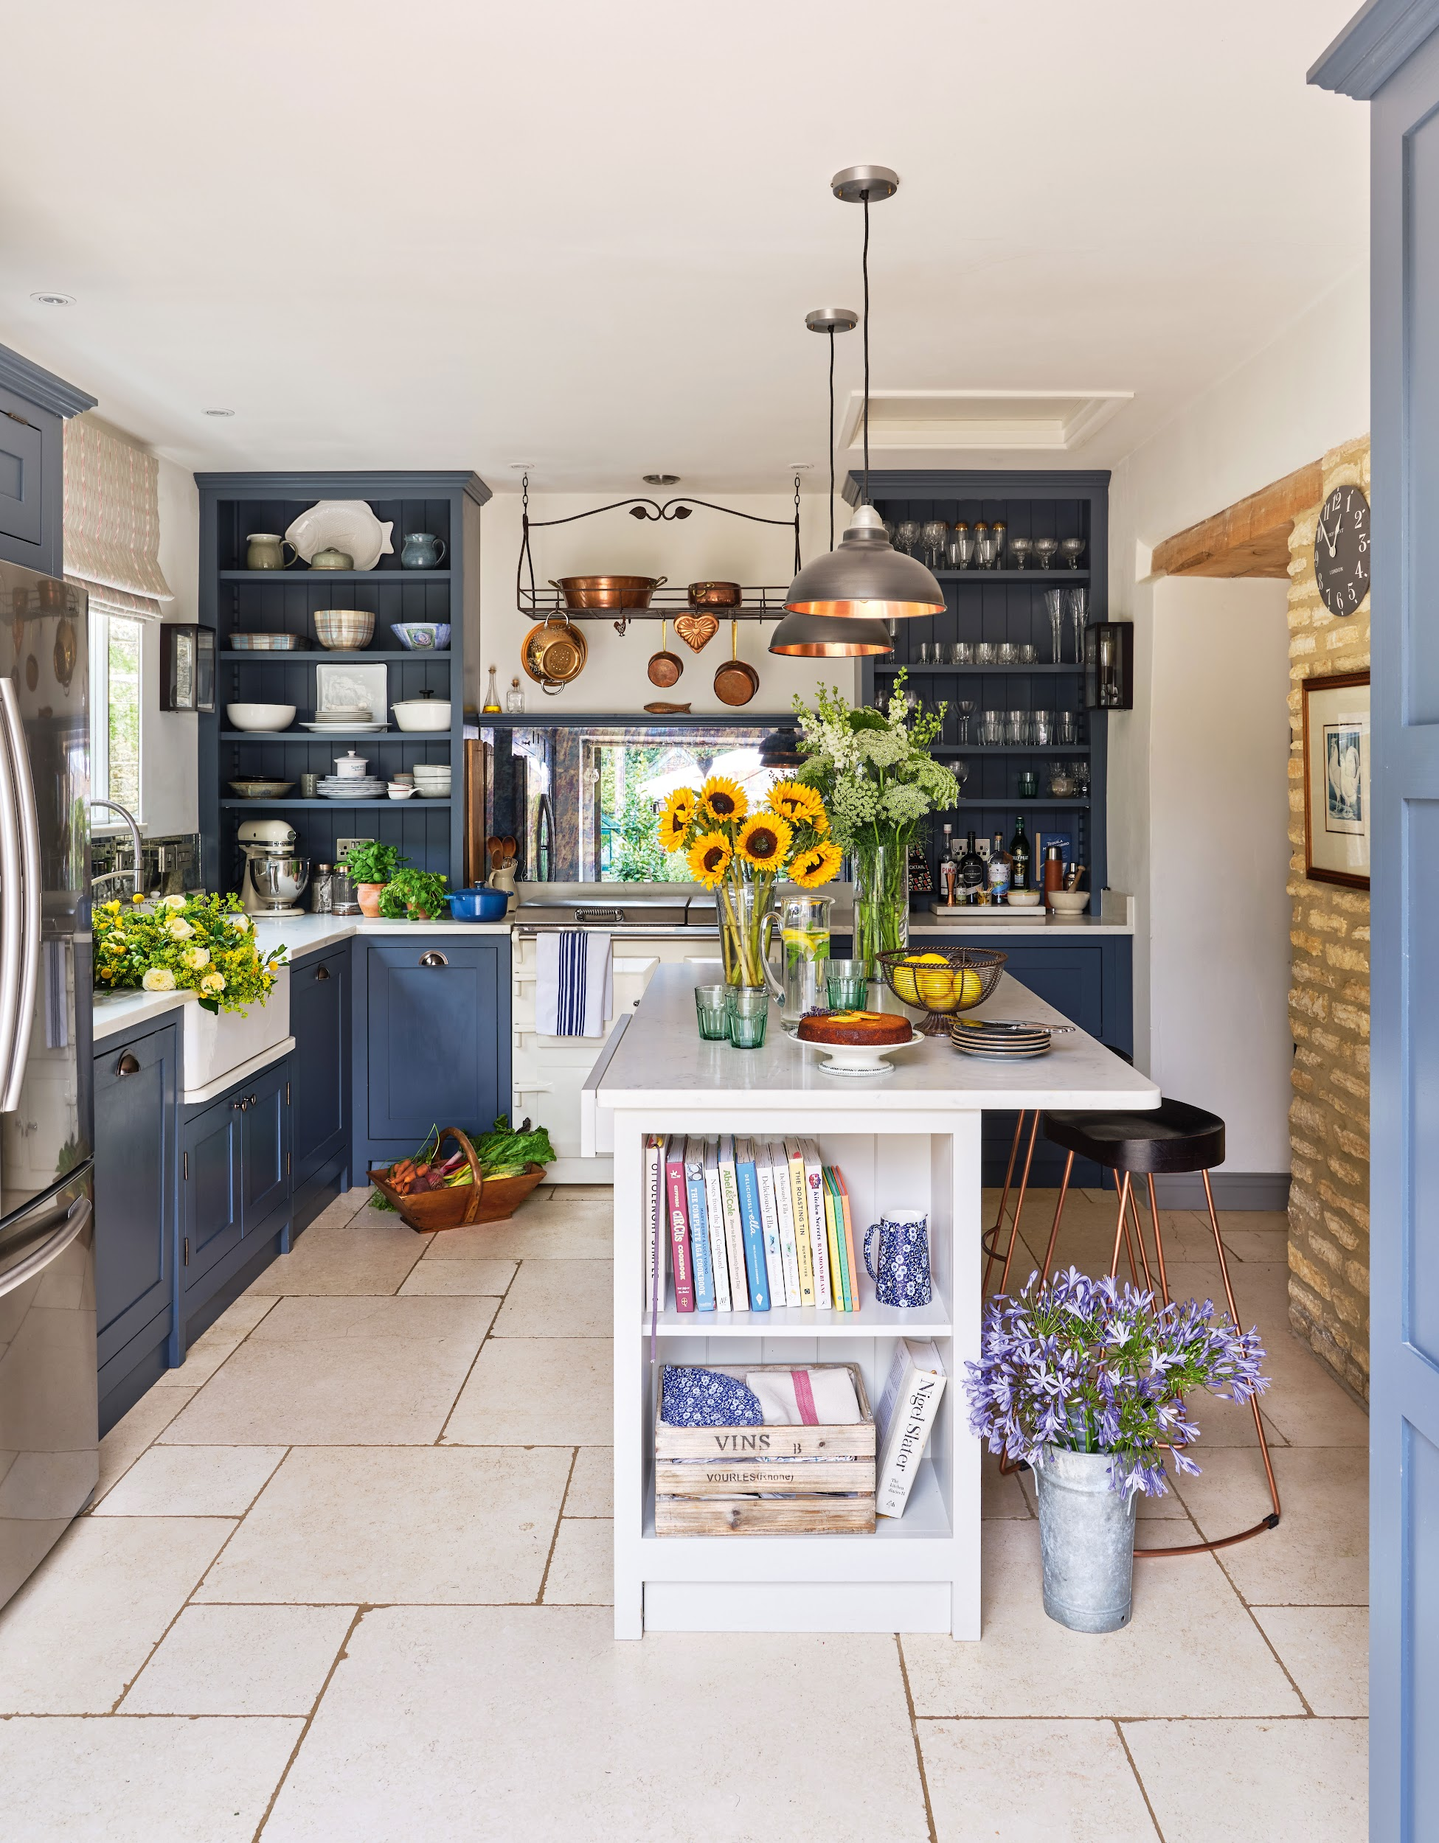
WHY PARTNER WITH PERIOD LIVING?
HERITAGE & TRUST
INTENT
ACTION
8 in 10 admit they feel more positive towards a brand after seeing a campaign via a Future Homes Title
4X more likely than the UK average to find magazine adverts the most helpful in aiding purchasing decision
1 in 3 people who saw a campaign through Future Homes titles, bought the product as a direct result.
*All numbers are averages from Future’s 2021 - 2022 campaigns and partnerships in the homes category, £100k+, UK; TGI, April 2024.

Slide 8


CONTENT CALENDAR 2024
NOV 23
OCT 23
DEC 23
NOV 23
JAN 24
DEC 23
FEB 24
JAN 24
MAR 24
FEB 24
APR 24
MAR 24
Carpets & Rugs
Heating Updates
Designing a Snug
Autumn Decorating
Buying an old home
Christmas
Dining Room styling
Wood burners
Festive decorating
Gift guide
Supplement TBC
New Year
New deco trends
Sustainable home
Lighting
Loft conversions & Extensions
Love your home
Upholstery
Beds
Kitchens
Spring clean
Wetrooms
Torage
Flooring
Let in light
Gardens rooms & Conservatories
Spring Deco
Windows
Shutters & Blinds
MAY 24
APR 24
JUN 24
MAY 24
JUL 24
JUN 24
AUG 24
JUL 24
SEP 24
AUG 24
OCT 24
SEP 24
Colourful home
Wall tiles
Paint inspiration
Living room
Print & pattern
Outdoor living
Greenhouses / Garden Buildings
Wallpaper focus
Doors
Patios
Summer revamp
Bathrooms
Hallways / staircases
Garden boundaries
Coastal dreams
Coastal Deco
Outdoor furniture
Pantries / Larders
Outdoor Lighting
Organised home
Home office / Library
Potted shed ideas
Floor tiles
Autumn loving
Bedrooms
Curtains/Blinds
Baths & Basins
Cover Date
Month On Sale
‹#›

Slide 9

THANK YOU

